Slide 1


High-Level Design
Group 6 - BookBuddi

Slide 2
Revision History
Rev No. | MODIFIED BY | MODIFIED DATE | REMARKS | PRELIMINARY REVIEW & APPROVAL | DATE REVIEWED | FINAL REVIEW & APPROVAL | DATE APPROVED
1.0 | Denampo, Elwison | 2025/08/23 | Initial Creation | Last Name, First Name | yyyy/mm/dd | Last Name, First Name | yyyy/mm/dd
1.1 | Denampo, Elwison | 2025/11/12 | Addition of the Missing Cover, Revision History, Function List | Last Name, First Name | yyyy/mm/dd | Last Name, First Name | yyyy/mm/dd
1.2 | Denampo, Elwison Rivera, Marc Gerard | 2025/11/13 | Revision of Jumpstart Progam Schedule | Last Name, First Name | yyyy/mm/dd | Last Name, First Name | yyyy/mm/dd
1.3 | Denampo, Elwison | 2025/11/15 | Revision of Function List (Added entries) | Last Name, First Name | yyyy/mm/dd | Last Name, First Name | yyyy/mm/dd
1.4 | Denampo, Elwison | 2025/11/17 | Revision of Jumpstart Progam Schedule, and Function List | Last Name, First Name | yyyy/mm/dd | Last Name, First Name | yyyy/mm/dd
1.5 | Denampo, Elwison | 2025/11/18 | Addition of Webapp Screenshots and Page Logic | Last Name, First Name | yyyy/mm/dd | Last Name, First Name | yyyy/mm/dd
1.6 | Denampo, Elwison | 2025/11/21 | Update of Webapp Screenshots | Last Name, First Name | yyyy/mm/dd | Last Name, First Name | yyyy/mm/dd

Slide 3
Overview
OVERVIEW | This web-based Library Management and Book Catalogue System allows users to browse a detailed book catalogue, borrow and return books, and request new titles. Administrators can securely manage the catalogue through an Admin Panel with tools for adding, editing, and deleting books. The system also includes a Reporting Module for tracking borrowing activity, inventory, members, and book requests. Additionally, users receive personalized notifications for updates such as request statuses, due dates, and overdue reminders.
EXPECTED USERS | Users, Admin
TECHNOLOGIES USED
PROGRAMMING LANGUAGE
FRONT-END | HTML, CSS, RAZOR
BACK-END | C#, ASP.NET Core
IDE | VS Code, VS Community 2022
DATA STORAGE / DB | Microsoft SQL Server
DESIGN TOOLS | Figma
AUTOMATED CODE REVIEW TOOLS | Github
PERFORMANCE TESTING TOOL | N/A
SCREEN RESOLUTION | 1920 x 1080
TOOLS USED | Github, Nuget Packages, Google Mail
SUPPORTED LANGUAGE | English
RELEASED VERSIONS (IF ANY) | Development
SCREEN DESIGN | Admin and User Screens
LIMITATIONS | Local Only
BROWSER SUPPORTED | Latest versions of Google Chrome, Mozilla Firefox, Microsoft Edge

Slide 4
HLD

Slide 5
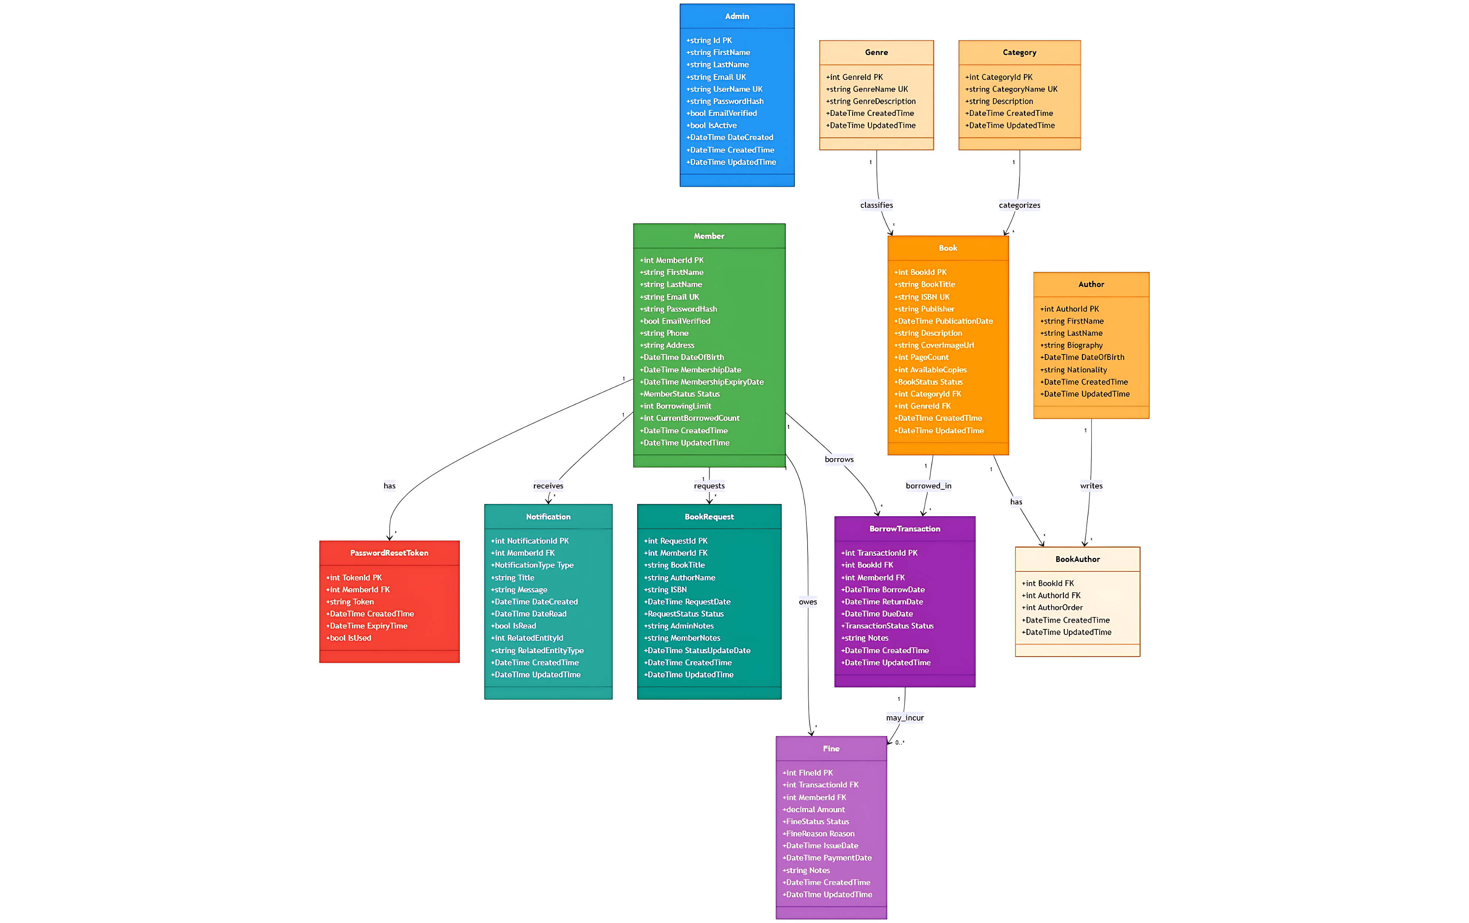
Entity Relationship Diagram
(ERD)

Slide 6
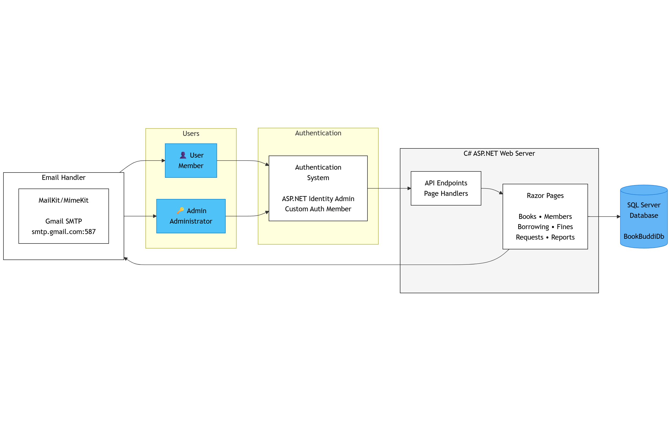
Architectural Diagram

Slide 7
SCREEN DETAILS

Slide 8
Screen List
SCREEN | DESCRIPTION | RIGHTS / PERMISSIONS |  | REMARKS
 |  | ADMIN | USER
1.0 Landing Page | Initial page displayed when accessing the system | x | x
2.0 Authentication | Authentication and user access management | x | x
2.1 Login Page | Authentication screen for system access | x | x
2.2 Register/Signup | User registration and account creation |  | x
3.0 Borrowing System | Interface for borrowing and returning books | x | x
4.0 DASHBOARD | Main overview screen showing system statistics and quick access | x
5.0 USER MANAGEMENT | Manage user accounts, roles, and permissions | x
6.0 NOTIFICATION (ADMIN) | Set up and manage email notification templates and triggers | x
7.0 NOTIFICATION (USERS) | User interface for viewing and managing notifications | x | x
7.1 Notification Dropdown | Quick access dropdown for recent notifications | x | x
7.2 Notification Page | Displays all notifications | x | x

Slide 9
Screen List
SCREEN | DESCRIPTION | RIGHTS / PERMISSIONS |  | REMARKS
 |  | ADMIN | USER
8.0 BOOK MANAGEMENT | Add, edit, delete, and manage book records | x
9.0 Book Catalogue | Browse and search available books | x | x
10.0 Category Management | Manage book categories and classifications | x
11.0 REPORTING | Access to various system reports | x
11.1 Borrowing Report | Report on borrowed books and transactions | x
11.2 Inventory Report | Current book inventory and stock levels | x
11.3 Member Report | User/member statistics and information | x
11.4 Request Report | Book requests and reservations | x
11.5 Lost Report | Track and manage lost or damaged books | x

Slide 10
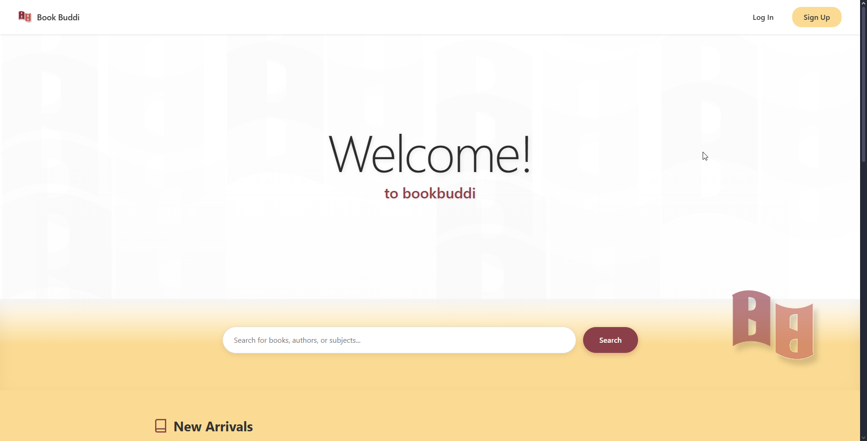
1.0 Landing Page

Slide 11
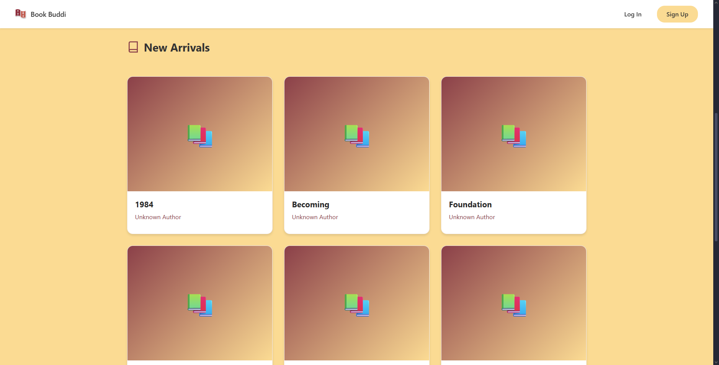
1.0 Landing Page

Slide 12
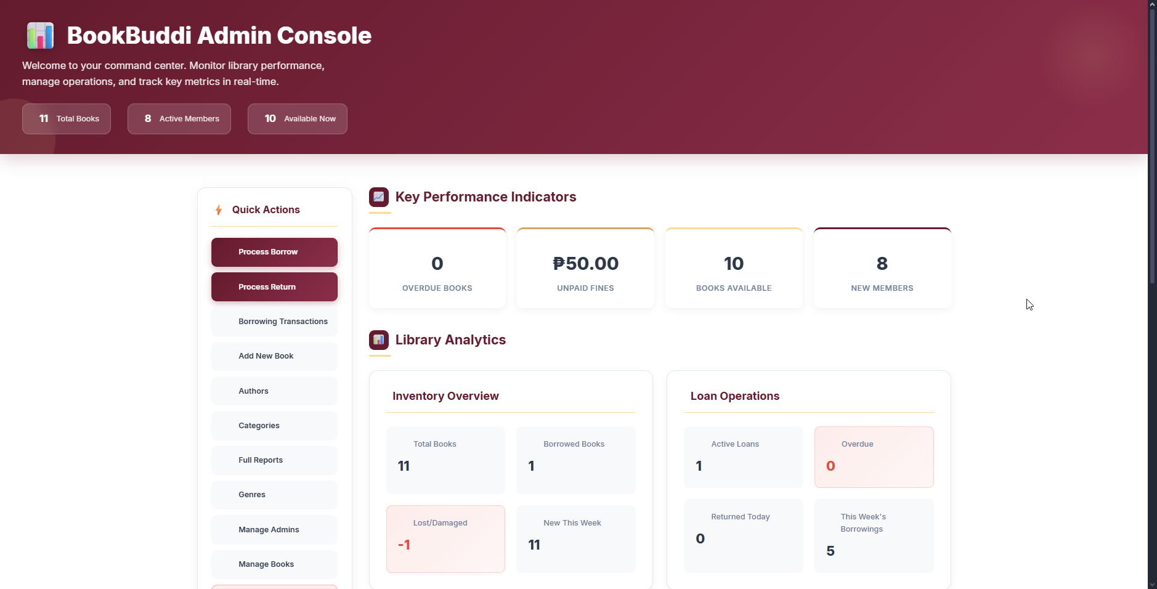
1.0 Landing Page

Slide 13
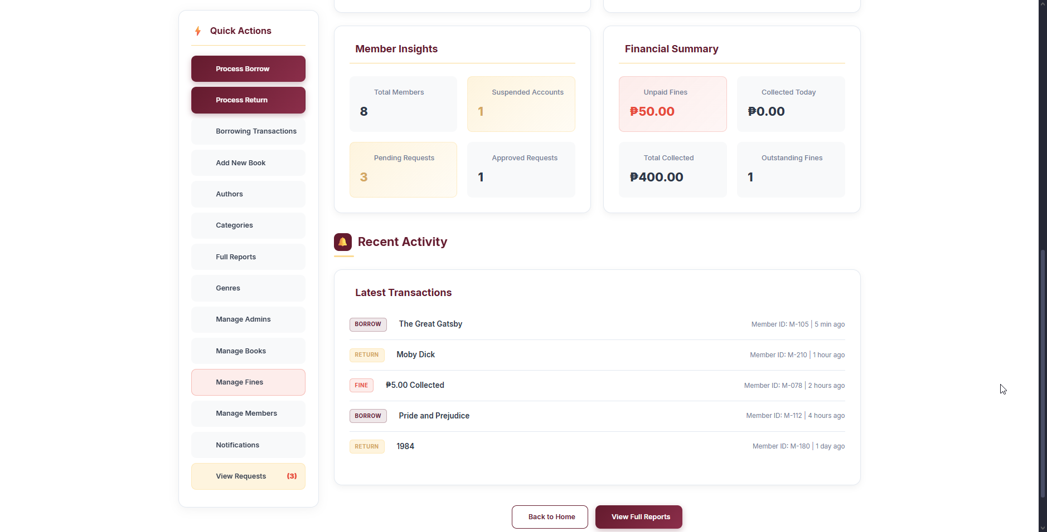
1.0 Landing Page

Slide 14
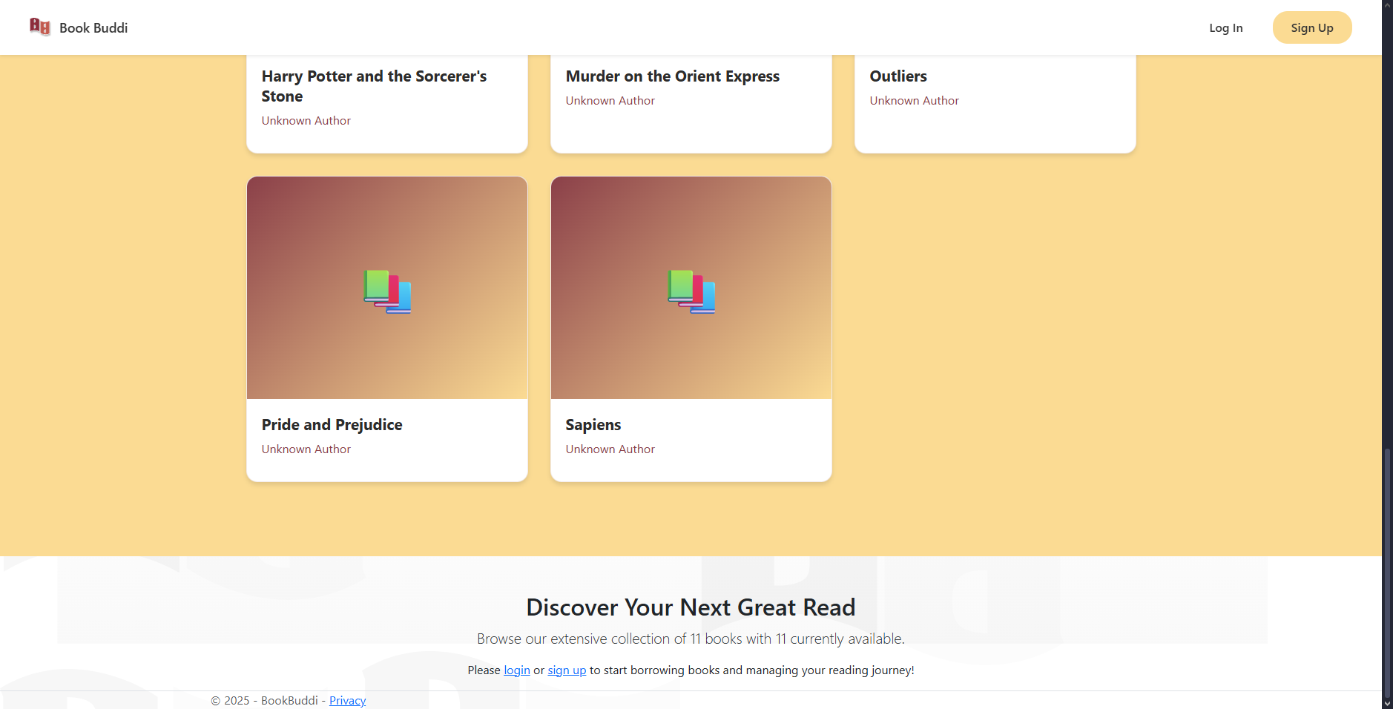
1.0 Landing Page

Slide 15
1.0 Landing Page Logic
Landing Page – Header
Field: Navigation menu
Logic: Role-based display
If not logged in: Show "Login" and "Sign Up" buttons
If Member: Show member name + "Logout"
If Admin: Show admin name + "Admin Panel" + "Logout"
Field: Logo
Logic: Anchor link to home
Action: Click logo
Action Logic: Navigate to home page (`/`)
Field: Mobile menu toggle
Logic: Responsive hamburger menu
Action: Click toggle button
Action Logic: Show/hide mobile navigation

Slide 16
1.0 Landing Page Logic
Landing Page – Hero Section
Field: Search bar
Logic: Search books by multiple criteria
Action: Enter search term
Action Logic: Filter books by title, author, ISBN, category, genre
Action: Submit search term
Action Logic: Reload page with search results; Update URL with query parameter
Field: Search results display
Logic: Conditional rendering
If search term provided: Show filtered results with count
If no results: Display "No books found" message
If no search: Show new arrivals section

Slide 17
1.0 Landing Page Logic
Landing Page – Book Cards
Field: New Arrivals section
Logic: Display recent books (first 8, ordered by creation date)
Action: Enter Page load
Action Logic: Query database for recent books; Render book grid
Field: Book card
Logic: Display book preview (cover, title, author)
Action: Click book card
Action Logic: Open book details modal
Field: Book modal
Logic: Show detailed book information
Display: Cover image, title, author, category, genre, ISBN, publisher, publication date, page count, available copies, description
Action: Click close button (×)
Action Logic: Hide modal
Action: Press Escape key
Action Logic: Close modal
Action: Click outside modal
Action Logic: Close modal

Slide 18
1.0 Landing Page Logic
Landing Page – Dashboard (Admin View)
Field: Statistics cards
Logic: Real-time database queries
Action: Enter Page load
Display metrics:
Total/Available/Borrowed/Lost/Damaged books
Total/Active/Suspended members
Active/Overdue transactions
Unpaid fines, collected fines
Action: Page load (if Admin)
Action Logic: Calculate all statistics from database
Field: Quick action buttons
Logic: Navigation shortcuts for admin tasks
Action: Click any quick action
Action Logic: Navigate to corresponding management page

Slide 19
1.0 Landing Page Logic
Landing Page – Footer
Field: Footer links
Logic: Static informational links
Action: Cick link
Action Logic: Navigate to respective page or section
Field: Copyright
Logic: Display current year
Action: Page render
Action Logic: Show copyright with dynamic year

Slide 20
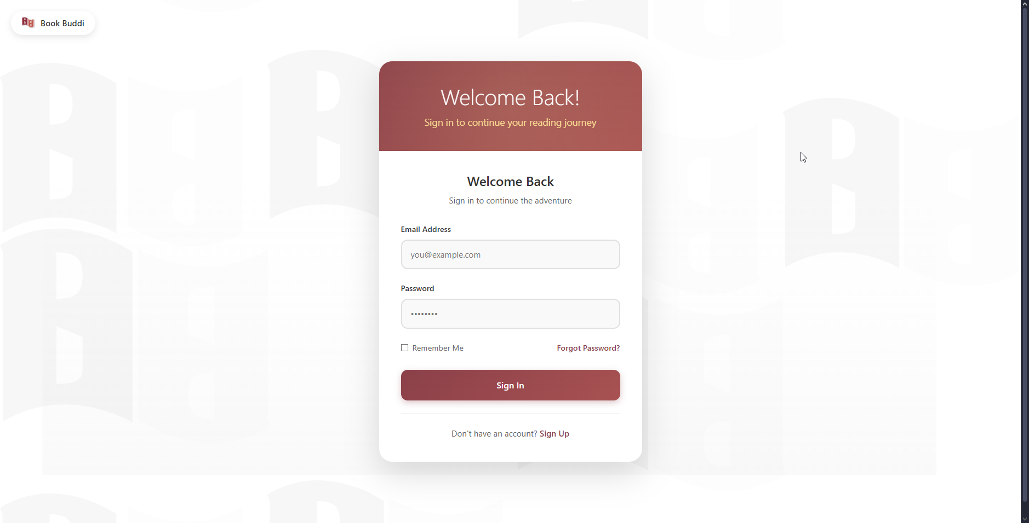
2.1 Authentication – Login Page

Slide 21
2.1 Authentication – Login Page Logic
Account/Login — Login Form
Field: Email input
Logic: Required field validation
Validation: Must be valid email format
Field: Password input
Logic: Required field; masked input
Validation: Not empty
Field: Remember Me checkbox
Logic: Optional persistent login
Action: Check/uncheck
Action Logic: Set cookie expiration (24 hours vs session)

Slide 22
2.1 Authentication – Login Page Logic
Account/Login — Login Form
Field: Sign In button
Logic: Form submission with dual authentication
Action: Click "Sign In"
Action Logic: Submit form; Validate credentials
Step 1: Try Member login
Validate email/password via IMemberService.ValidateCredentials()
Check email verification status (if required)
Check member status (Active/Suspended/Expired/Inactive)
If valid and Active: Store session (MemberId, MemberName, UserRole="Member")
Redirect to /Books/Index
Step 2: If member login fails, try Admin login
Find admin by email via UserManager
Verify password via SignInManager
Check admin IsActive status
If valid: Store session (UserRole="Admin", AdminName, AdminEmail)
Redirect to /Admin/Index
Step 3: If both fail
Display error: "Invalid email or password"

Slide 23
2.1 Authentication – Login Page Logic
Account/Login — Login Form
Field: Forgot Password link
Logic: Navigate to password reset
Action: Click "Forgot Password?"
Action Logic: Redirect to /Account/ForgotPassword
Field: Sign Up link
Logic: Navigate to registration
Action: Click "Sign Up"
Action Logic: Redirect to /Account/Register

Slide 24
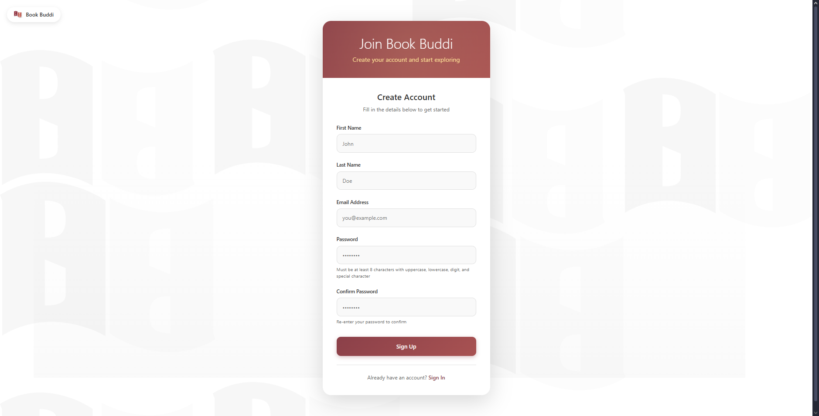
2.2 Authentication – Registration Page

Slide 25
2.2 Authentication – Registration Page Logic
Account/Register — Registration Form
Field: First Name input
Logic: Required field
Validation: Not empty; max 100 characters
Field: Last Name input
Logic: Required field
Validation: Not empty; max 100 characters
Field: Email input
Logic: Required field; unique constraint
Validation: Valid email format; check if email already exists
Field: Password input
Logic: Required field; strength requirements
Validation: Minimum 8 characters; Must contain uppercase, lowercase, digit, special character
Display: Password requirements hint below field
Field: Confirm Password input
Logic: Required field; match validation
Validation: Must match Password field exactly

Slide 26
2.2 Authentication – Registration Page Logic
Account/Register — Registration Form
Field: Sign Up button
Logic: Form submission with account creation
Action: Click "Sign Up"
Action Logic: Submit form; Validate all fields
Check passwords match
Validate password strength
Check email uniqueness
Generate verification token (32-byte random, Base64 encoded)
Generate 6-digit verification code (100000-999999)
Set token expiry (24 hours from now)
Create member account with Status=Active, BorrowingLimit=5
Set membership expiry (1 year from now)
Set EmailVerified=false
Store verification token, code, and expiry
Add member to database via IMemberService.AddMember()
Send verification email via IEmailService.SendMemberVerificationEmailAsync()
If EmailVerificationRequired: Redirect to /Account/EnterVerificationCode?email={email}
Otherwise: Show success message with 3-second countdown; Auto-redirect to /Account/Login

Slide 27
2.2 Authentication – Registration Page Logic
Account/Register — Registration Form
Field: Success countdown
Logic: Auto-redirect timer
Display: "Account created successfully! Redirecting to login in 3... 2... 1..."
Action: Countdown reaches 0
Action Logic: Navigate to /Account/Login
Field: Sign In link
Logic: Navigate to login
Action: Click "Sign In"
Action Logic: Redirect to /Account/Login

Slide 28
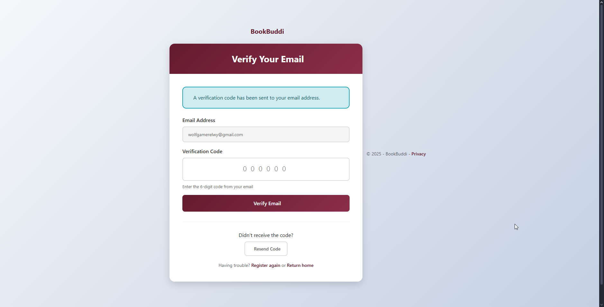
2.3 Authentication – Verification Page

Slide 29
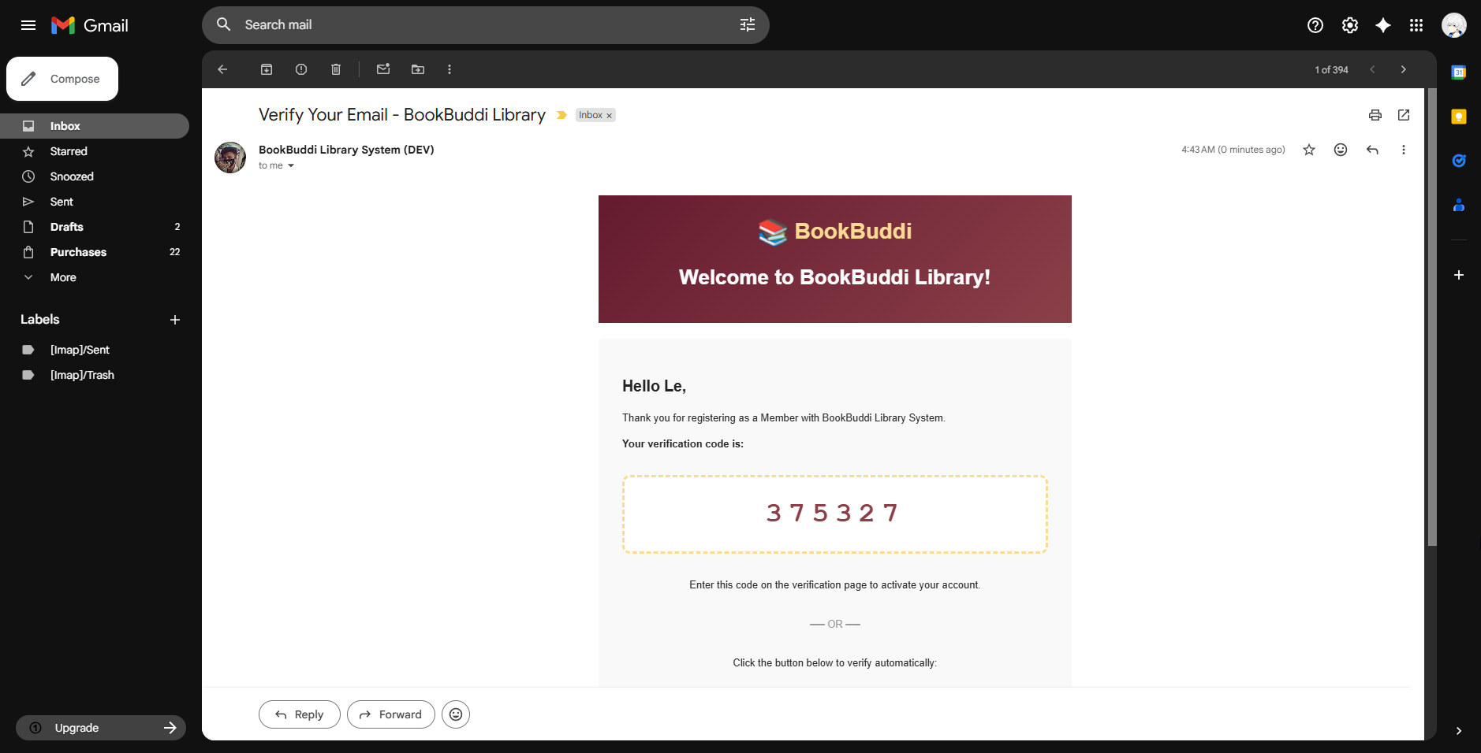
2.3 Authentication – Verification Page

Slide 30
2.3 Authentication - Verification Page Logic
Account/EnterVerificationCode — Code Verification
Field: Email display
Logic: Read-only display of registered email
Display: Email address from query parameter
Field: Verification code input
Logic: 6-digit numeric code entry
Validation: Exactly 6 digits; numeric only
Display: Monospace font, centered, large text
JavaScript: Auto-submit when 6 digits entered; Prevent non-digit input

Slide 31
2.3 Authentication - Verification Page Logic
Account/EnterVerificationCode — Code Verification
Field: Verify Email button
Logic: Code verification submission
Action: Click "Verify Email"
Action Logic: Submit form; Validate code
Find member by verification code via IMemberService.GetMemberByVerificationCode(code)
Check email matches
Check token not expired
Check not already verified
If valid: Set EmailVerified=true; Clear verification token, code, and expiry; Update member
Display success message
Show "Go to Login" button

Slide 32
2.3 Authentication - Verification Page Logic
Account/EnterVerificationCode — Code Verification
Field: Resend Code button
Logic: Request new verification code
Action: Click "Resend Code"
Action Logic: Generate new code; Send new email; Display alert (placeholder)
Field: Go to Login button
Logic: Navigate to login after success
Action: Click "Go to Login"
Action Logic: Redirect to /Account/Login

Slide 33
2.3 Authentication - Verification Page Logic
Account/VerifyEmail — Link Verification
Field: Loading spinner
Logic: Initial state while processing
Display: Animated spinner during verification
Field: Verification process
Logic: Automatic token-based verification
Action: Page load with token parameter
Action Logic: Extract token from URL query string
Validate token parameter exists
Find member by token via IMemberService.GetMemberByVerificationToken(token)
Check token not expired (compare with current time)
Check not already verified
If valid: Set EmailVerified=true; Clear token, code, and expiry; Update member; Show success card
If invalid/expired: Show error card with appropriate message

Slide 34
2.3 Authentication - Verification Page Logic
Account/VerifyEmail — Link Verification
Field: Success card
Logic: Display verification success
Display: Green checkmark icon; Success message
Action: Click "Go to Login"
Action Logic: Redirect to /Account/Login
Field: Error card
Logic: Display verification failure
Display: Red X icon; Error message (expired/invalid/already verified)
Action: Click "Register Again"
Action Logic: Redirect to /Account/Register
Action: Click "Try to Login"
Action Logic: Redirect to /Account/Login

Slide 35
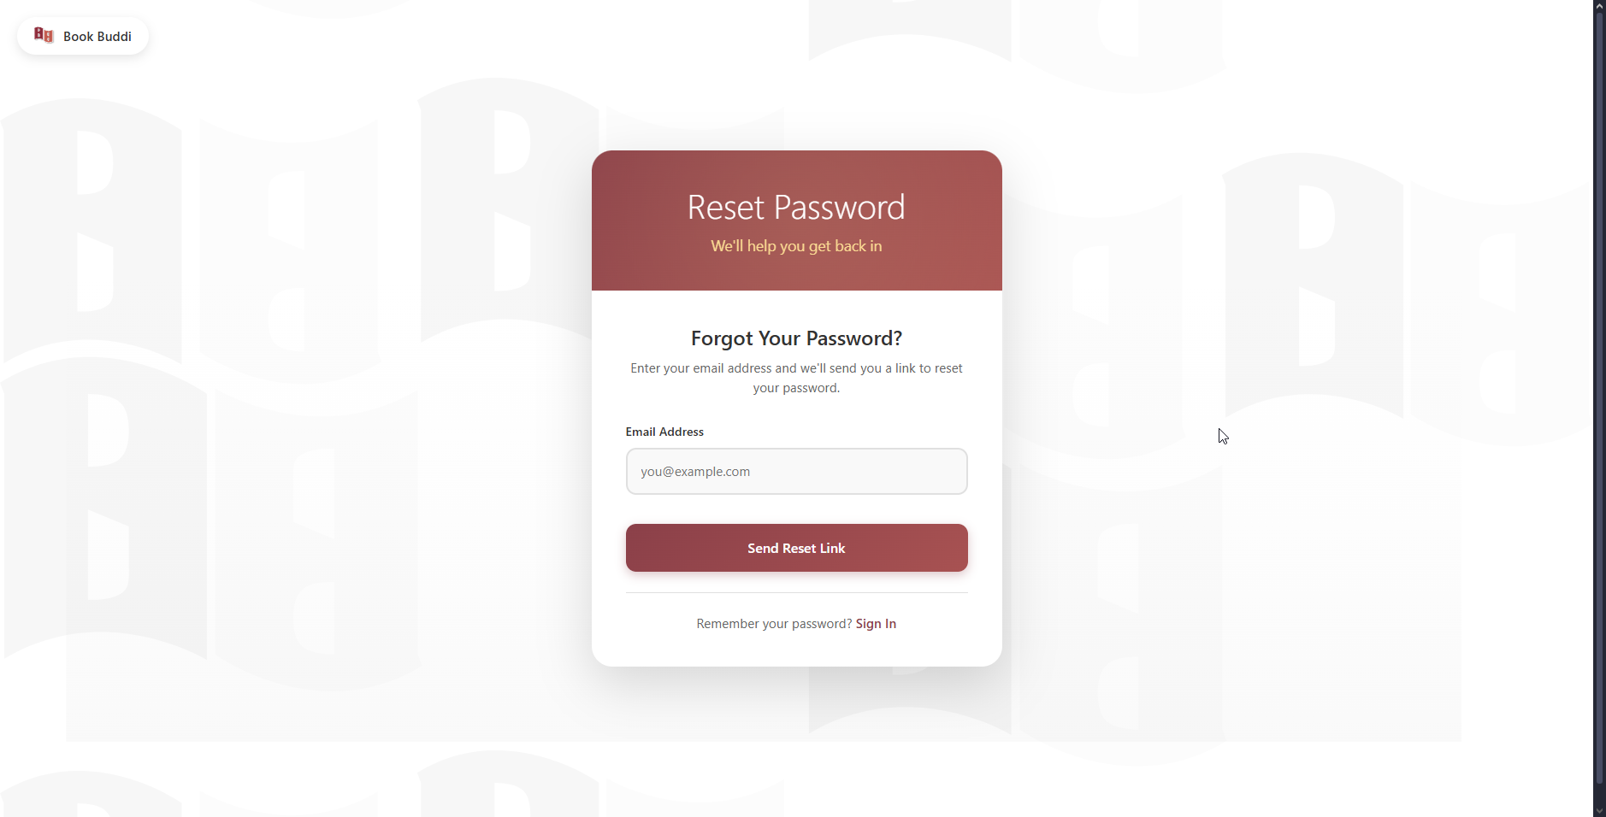
2.4 Authentication – Forgot Password Page

Slide 36
2.4 Authentication – Forgot Password Page Logic
Account/ForgotPassword — Password Reset Request
Field: Email input
Logic: Required field for password reset
Validation: Valid email format
Field: Send Reset Link button
Logic: Generate and email reset token
Action: Click "Send Reset Link"
Action Logic: Submit form
Validate email format
Generate password reset token via IMemberService.GeneratePasswordResetToken(email)
Build reset URL with token: {ApplicationUrl}/Account/ResetPassword?token={token}
Get member info by email
Send reset email via IEmailService.SendPasswordResetEmailAsync()
In development mode: Display reset link in success message
Show generic success message (security: don't reveal if email exists)
Field: Sign In link
Logic: Navigate to login
Action: Click "Sign In"
Action Logic: Redirect to /Account/Login

Slide 37
2.5 Authentication – Logout Logic
Account/Logout - Logout Process
Logic: Automatic session termination
Action: Page access
Action Logic: Clear all session data (MemberId, MemberName, UserRole, AdminName, AdminEmail)
If Admin: Sign out via SignInManager
Redirect to home page (/)

Slide 38
3.0 Admin – Dashboard Page

Slide 39
3.0 Admin – Dashboard Page

Slide 40
3.0 Admin – Dashboard Page Logic
Admin/Index — Dashboard
Field: Inventory Overview cards
Logic: Real-time book statistics
Display: Total Books, Available Books (with % bar), Borrowed Books, Lost/Damaged Books
Action: Page load
Action Logic: Query database for book counts by status
Total: Count all books
Available: Count books with AvailableCopies > 0
Borrowed: Count books in active transactions
Lost/Damaged: Count books with Lost/Damaged status
Field: Members Overview cards
Logic: Member statistics
Display: Total Members, Active Members, Suspended Members, New This Week
Action: Page load
Action Logic: Query Members table
Total: Count all members
Active: Count members with Status=Active
Suspended: Count members with Status=Suspended
New This Week: Count members created in last 7 days

Slide 41
3.0 Admin – Dashboard Page Logic
Admin/Index — Dashboard
Field: Borrowing Activity cards
Logic: Transaction statistics
Display: Active Loans, Overdue (with warning icon), Returned Today, This Week
Action: Page load
Action Logic: Query BorrowTransactions table
Active: Count transactions with Status=Active
Overdue: Count transactions with Status=Overdue
Returned Today: Count transactions returned today
This Week: Count transactions created in last 7 days
Field: Financial Overview cards
Logic: Fine statistics
Display: Unpaid Fines (amount + count), Collected Today, Total Collected
Action: Page load
Action Logic: Query Fines table
Unpaid: Sum amount where Status=Unpaid
Collected Today: Sum amount where PaymentDate=Today
Total: Sum all paid fines

Slide 42
3.0 Admin – Dashboard Page Logic
Admin/Index — Dashboard
Field: Book Requests cards
Logic: Request statistics
Display: Pending Requests, Approved, Rejected
Action: Page load
Action Logic: Query BookRequests table; Count by Status
Field: Catalog Data cards
Logic: Catalog statistics
Display: Categories count, Genres count, Authors count, New Books This Week
Action: Page load
Action Logic: Query respective tables for counts

Slide 43
3.0 Admin – Dashboard Page Logic
Admin/Index — Dashboard
Field: Quick Actions grid
Logic: Navigation shortcuts (10 buttons)
Action: Click any quick action button
"Create Account" → Navigate to /Admin/CreateAccount
"Manage Admins" → Navigate to /Admin/ManageAdmins
"Manage Members" → Navigate to /Members/Index
"Add New Book" → Navigate to /Books/Create
"Manage Categories" → Navigate to /Categories/Index
"Manage Genres" → Navigate to /Genres/Index
"Process Borrow" → Navigate to /Borrowing/Borrow
"Process Return" → Navigate to /Borrowing/Return
"View Requests" → Navigate to /BookRequests/Index
"Full Reports" → Navigate to /Reports/Index

Slide 44
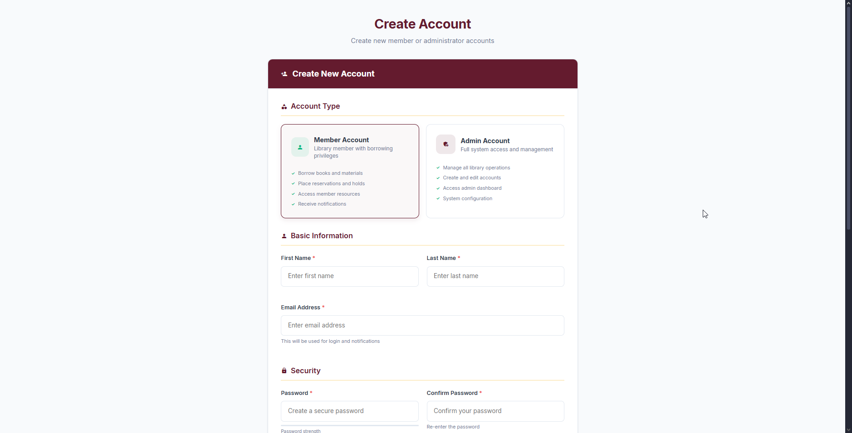
3.1 Admin – Create Account Page

Slide 45
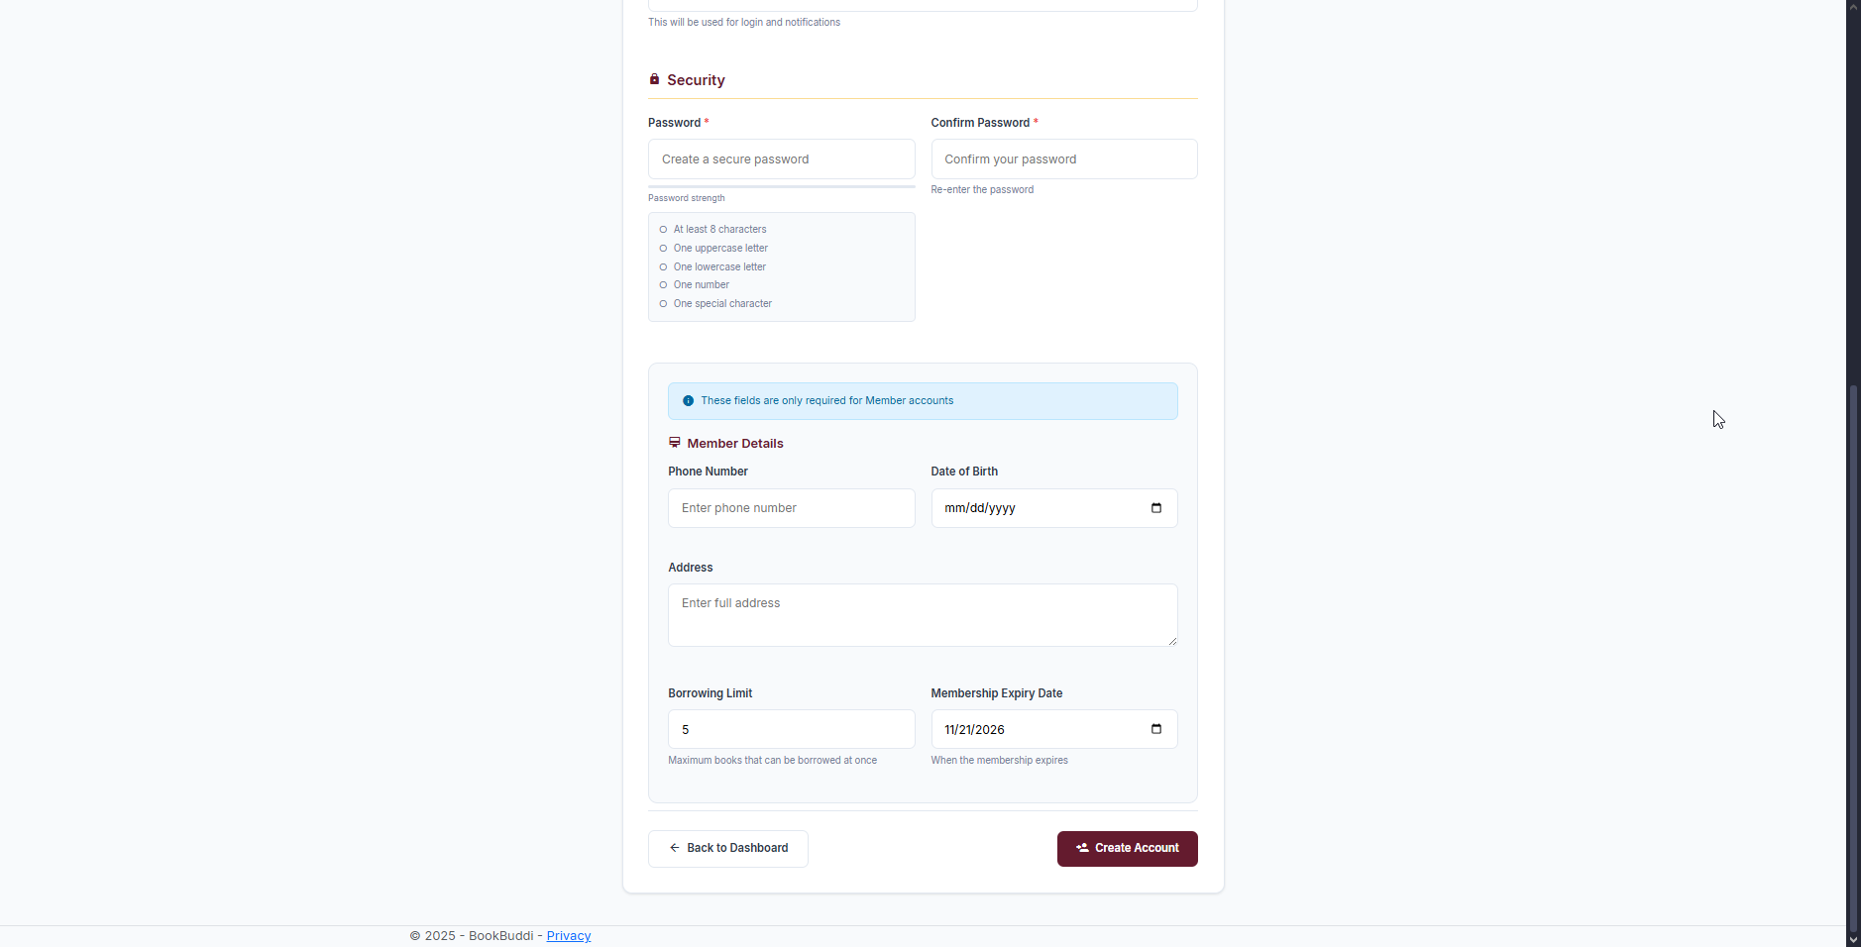
3.1 Admin – Create Account Page

Slide 46
3.1 Admin – Create Account Page Logic
Admin/CreateAccount — Account Creation
Field: Account Type radio buttons
Logic: Toggle between Member and Admin creation
Options: "Member Account" (default), "Admin Account"
Action: Change selection
Action Logic: JavaScript toggles visibility of "Member Details" section
Member selected: Show Member Details (phone, DOB, address, limits)
Admin selected: Hide Member Details
Field: Basic Information section
First Name input: Required, max 100 chars
Last Name input: Required, max 100 chars
Email input: Required, valid format, unique constraint
Password input: Required, min 8 chars, strength validation
Confirm Password input: Required, must match Password
Field: Member Details section (conditional)
Phone Number input: Optional, max 20 chars
Date of Birth input: Optional, date picker
Address textarea: Optional, max 500 chars
Borrowing Limit input: Required, number 1-20, default 5
Membership Expiry Date input: Date picker, defaults to 1 year from now

Slide 47
3.1 Admin – Create Account Page Logic
Admin/Index — Dashboard
Field: Back to Dashboard button
Logic: Cancel and return
Action: Click "Back to Dashboard"
Action Logic: Redirect to /Admin/Index

Slide 48
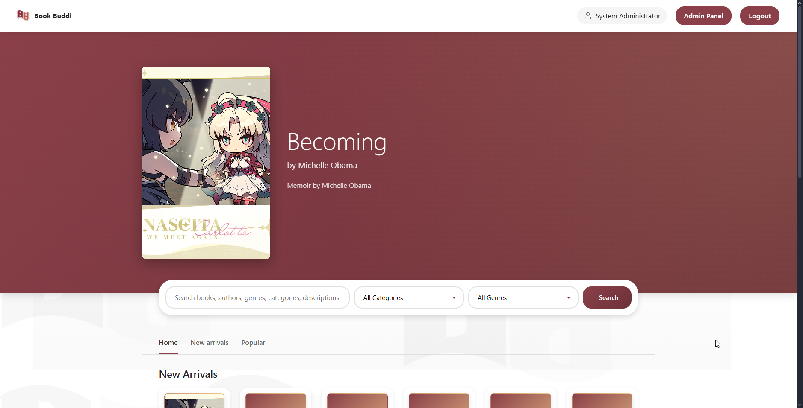
4.0 Books – Catalog Page

Slide 49
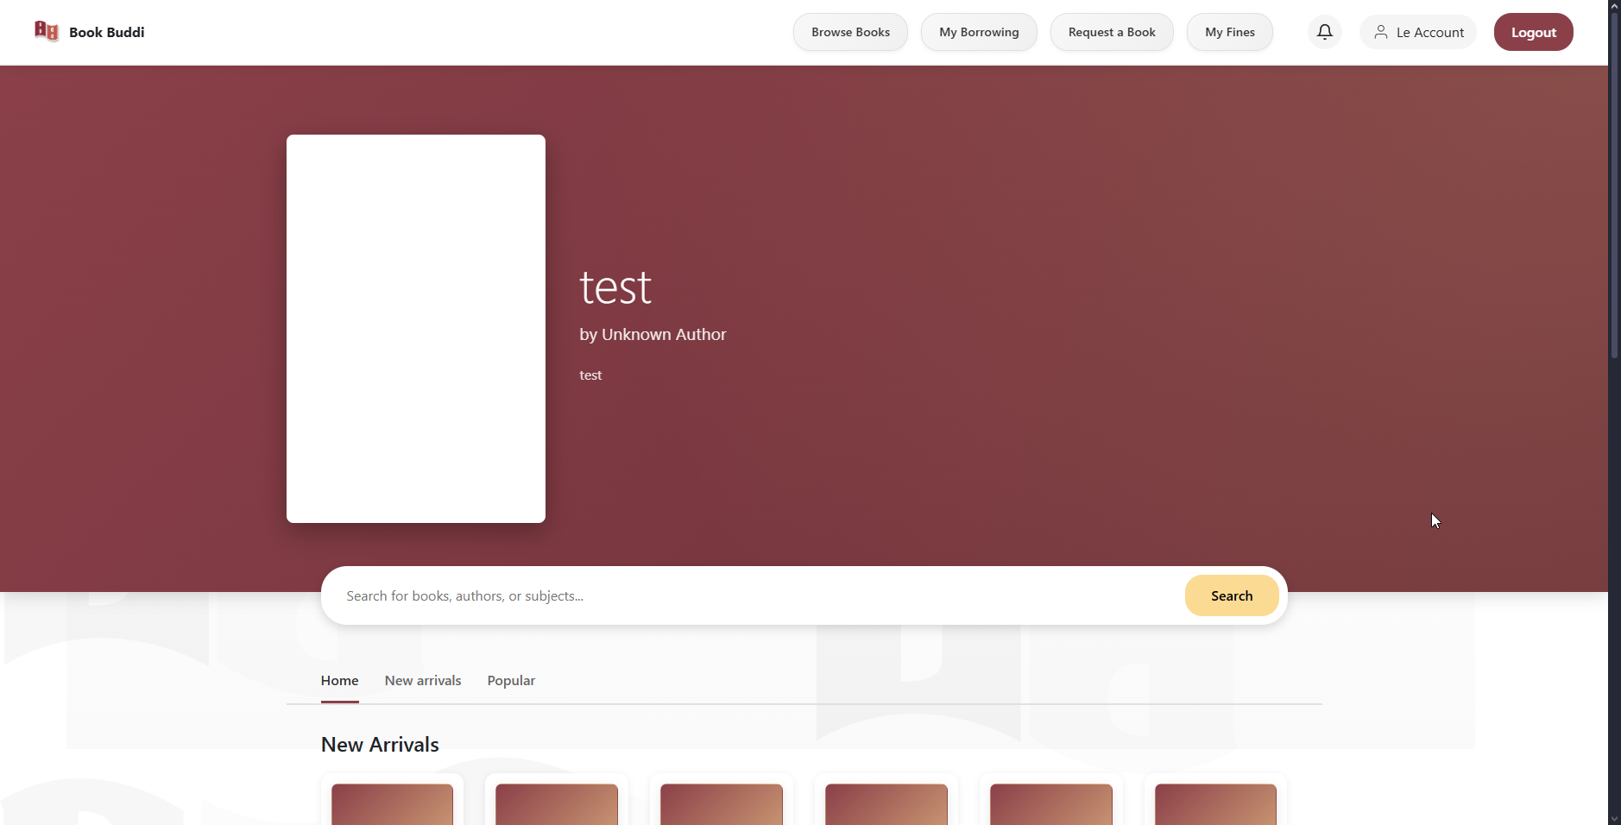
4.0 Books – Catalog Page

Slide 50
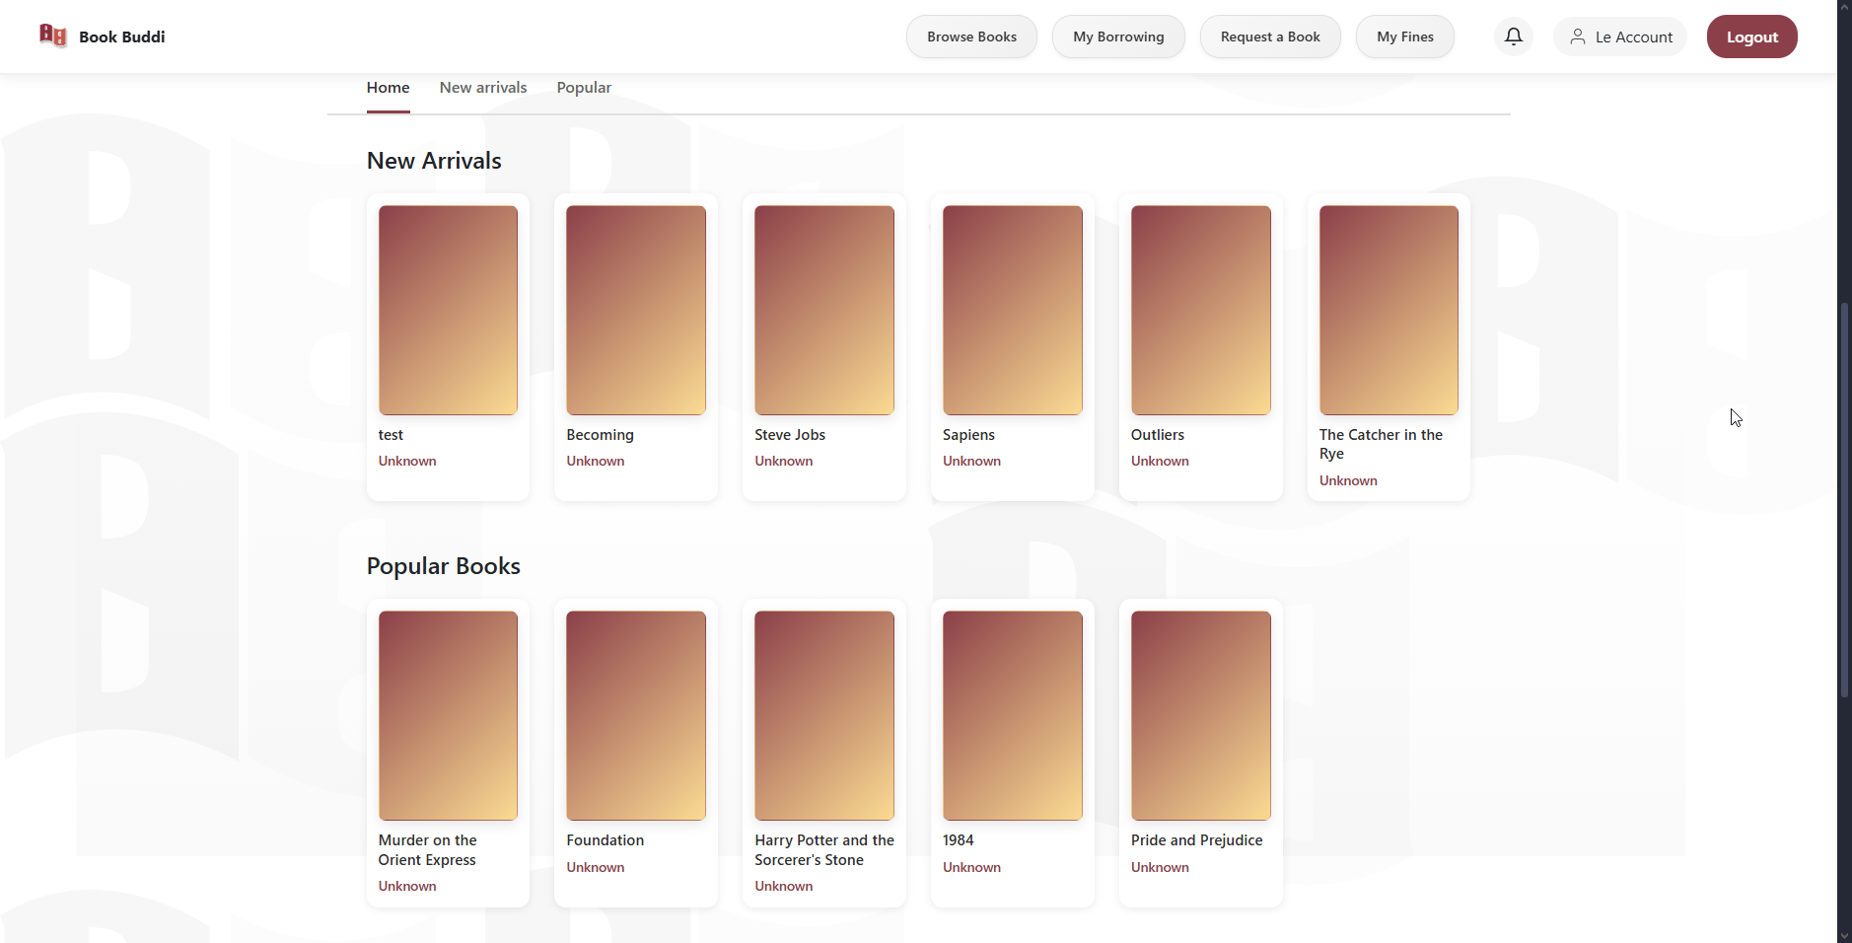
4.0 Books – Catalog Page

Slide 51
4.0 Books – Catalog Page Logic
Books/Index — Catalog
Field: Navigation bar
Logic: Role-based menu display
If Member: Show "Browse Books", "My Borrowing", "Request a Book", "My Fines"
If Admin: Show "Admin Panel" button
Action: Click menu item
Action Logic: Navigate to respective page
Field: Notification bell
Logic: Display unread count; dropdown panel
Display: Badge with unread notification count
Action: Click bell icon
Action Logic: JavaScript toggleNotifications(); Toggle dropdown visibility
Action: Click outside dropdown
Action Logic: Close dropdown

Slide 52
4.0 Books – Catalog Page Logic
Books/Index — Catalog
Field: Notification dropdown
Logic: Show recent notifications (top 5)
Display: Tabs (View all, Due date, Request, System Alerts) with badges
Action: Click tab
Action Logic: JavaScript switchTab(event, tabName); Filter notifications by type
Action: Click notification card
Action Logic: JavaScript openNotificationModal(); Display in modal; Mark as read option
Action: Click "Mark All as Read"
Action Logic: Navigate to /Notifications/MarkAllRead?memberId={id}&returnUrl={current}
Action: Click "View All Notifications"
Action Logic: Navigate to /Notifications/Index
Field: Featured book section
Logic: Display hero book with large cover
Display: Featured book cover (300x450px), title, author, description snippet

Slide 53
4.0 Books – Catalog Page Logic
Books/Index — Catalog
Field: Search bar
Logic: Search books by multiple criteria
Action: Enter search term; Click "Search"
Action Logic: Submit form (GET); Reload page with searchTerm parameter
Call IBookService.SearchBooks(searchTerm)
Search in: BookTitle, Author.FirstName, Author.LastName, Category.Name, Genre.Name, ISBN
Display filtered results
Field: Navigation tabs
Logic: Filter book display
Tabs: "Home" (default), "New arrivals", "Popular"
Action: Click tab
Action Logic: Navigate with filter parameter
"Home" → /Books/Index?filter=home (24 books)
"New arrivals" → /Books/Index?filter=new (12 newest books)
"Popular" → /Books/Index?filter=popular (12 books ordered by ID)

Slide 54
4.0 Books – Catalog Page Logic
Books/Index — Catalog
Field: Book cards grid
Logic: Display book collection
Each card: Cover image, title, author name (clickable)
Action: Click book card
Action Logic: Navigate to /Books/Details?id={bookId}
Field: Notification modal
Logic: Display full notification details
Display: Title, message, date/time metadata
Action: Click "Mark as Read" (if unread)
Action Logic: Navigate to /Notifications/MarkRead?id={id}&memberId={memberId}&returnUrl={current}
Action: Click "Close" or Press Escape
Action Logic: JavaScript close modal

Slide 55
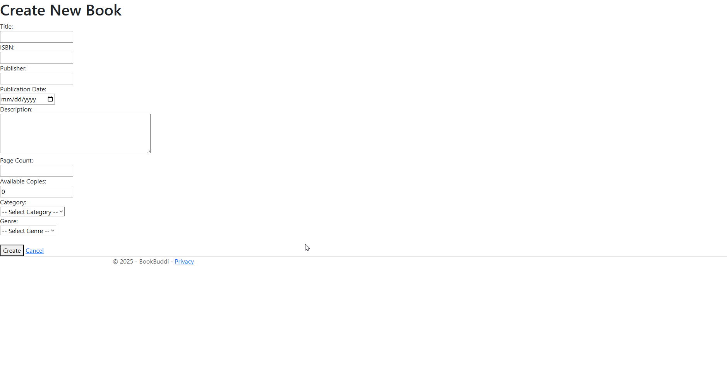
4.1 Books – Create Book Page

Slide 56
4.1 Books – Create Book Page Logic
Books/Create — Add New Book
Field: Book form
Title input: Required, max 300 chars
ISBN input: Required, 13 chars, unique constraint
Publisher input: Optional, max 200 chars
Publication Date input: Optional, date picker
Category dropdown: Required, populated from Categories table
Genre dropdown: Required, populated from Genres table
Description textarea: Optional, max 2000 chars
Page Count input: Optional, number
Available Copies input: Required, number, min 0
Cover Image URL input: Optional, max 500 chars
Status dropdown: Required, options: Available, Unavailable, Archived

Slide 57
4.1 Books – Create Book Page Logic
Books/Create — Add New Book
Field: Create Book button
Logic: Add book to database
Action: Click "Create Book"
Action Logic: Submit form; Validate fields
Check ISBN not already in use
Get admin name from session (CreatedBy)
Call IBookService.AddBook(book, adminName)
Redirect to /Books/Index with success message
OnGet Logic:
Authorization check: Admin only
Load dropdowns: Fetch all Categories and Genres from database

Slide 58
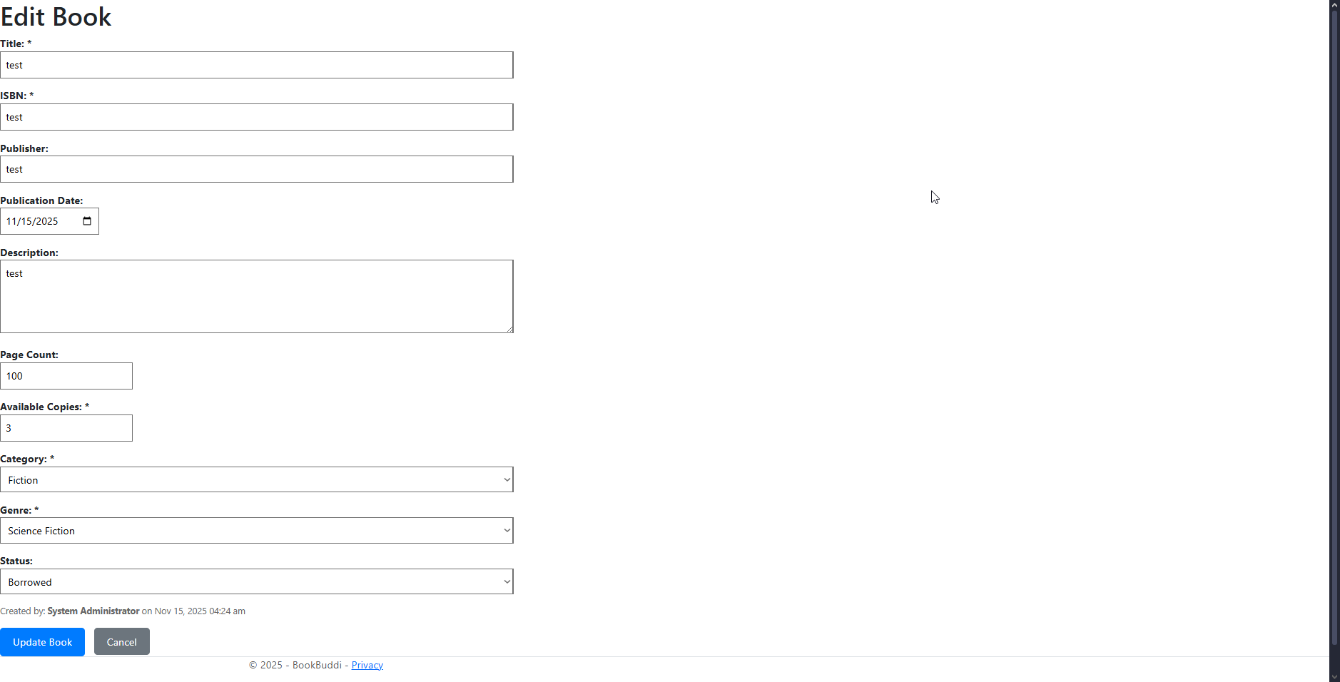
4.2 Books – Edit Page

Slide 59
4.2 & 4.3 Books – Edit Page Logic
Books/Edit — Update Book
Logic: Similar to Create
OnGet: Load existing book data; Populate form; Load dropdowns
OnPost: Validate; Call IBookService.UpdateBook(); Redirect
Books/Delete — Remove Book
Field: Book details display
Logic: Confirmation before deletion
Display: All book information (read-only)
Field: Confirm Delete button
Logic: Soft or hard delete
Action: Click "Confirm Delete"
Action Logic: Call IBookService.DeleteBook(id, adminName); Redirect to /Books/Index

Slide 60
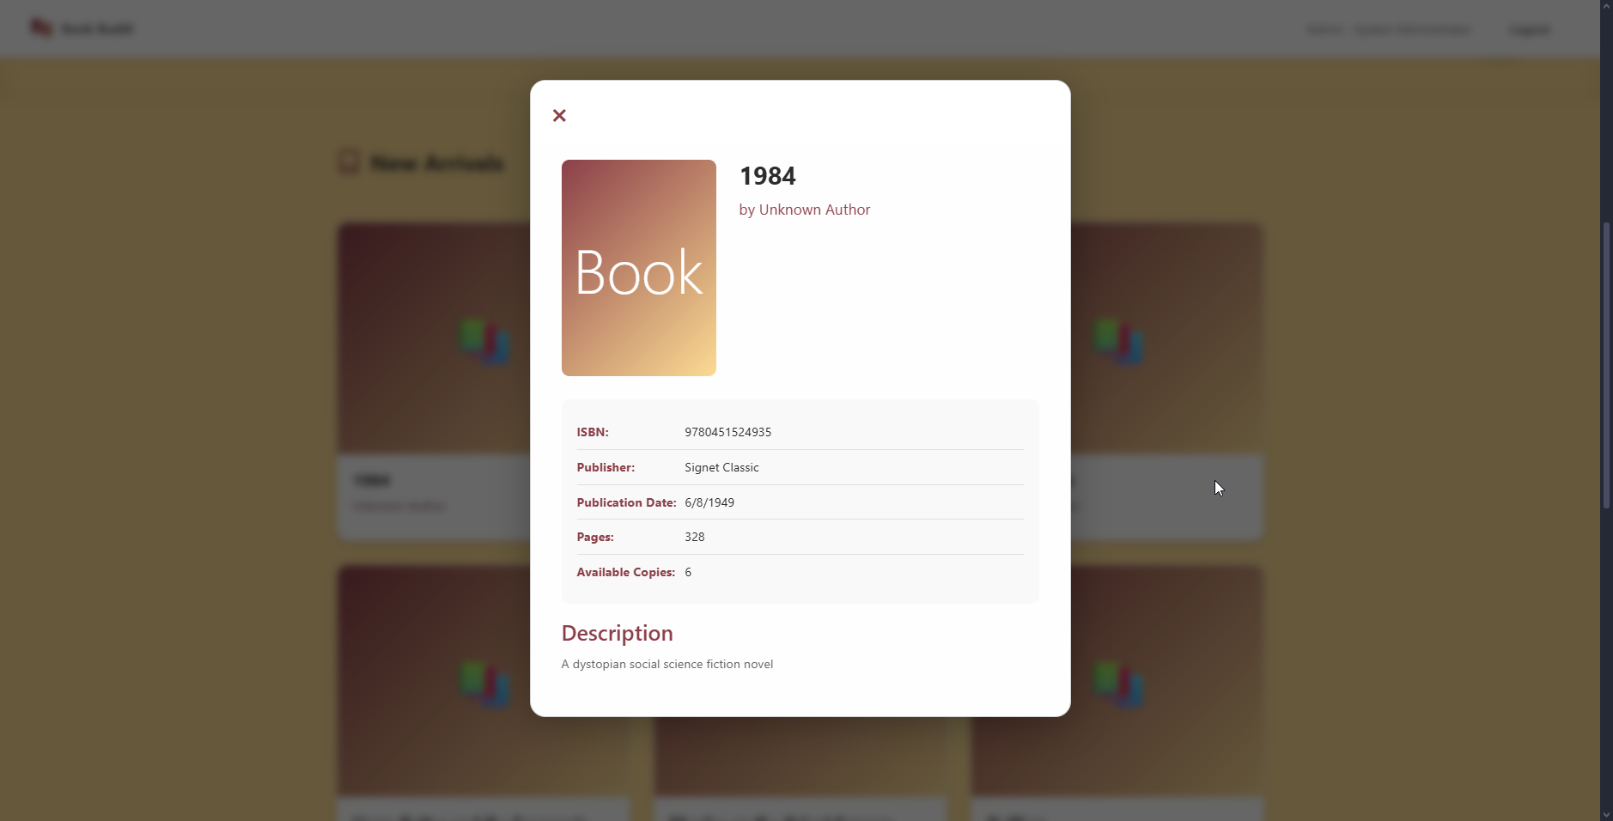
4.4 Books – Detail Page

Slide 61
4.4 Books – Detail Page Logic
Books/Details — View Book
Field: Book information display
Logic: Read-only detailed view
Display: Cover image, title, authors, ISBN, publisher, publication date, category, genre, description, page count, available copies, status
Action: Page load with id parameter
Action Logic: Fetch book by ID; Include related data (authors, category, genre)

Slide 62
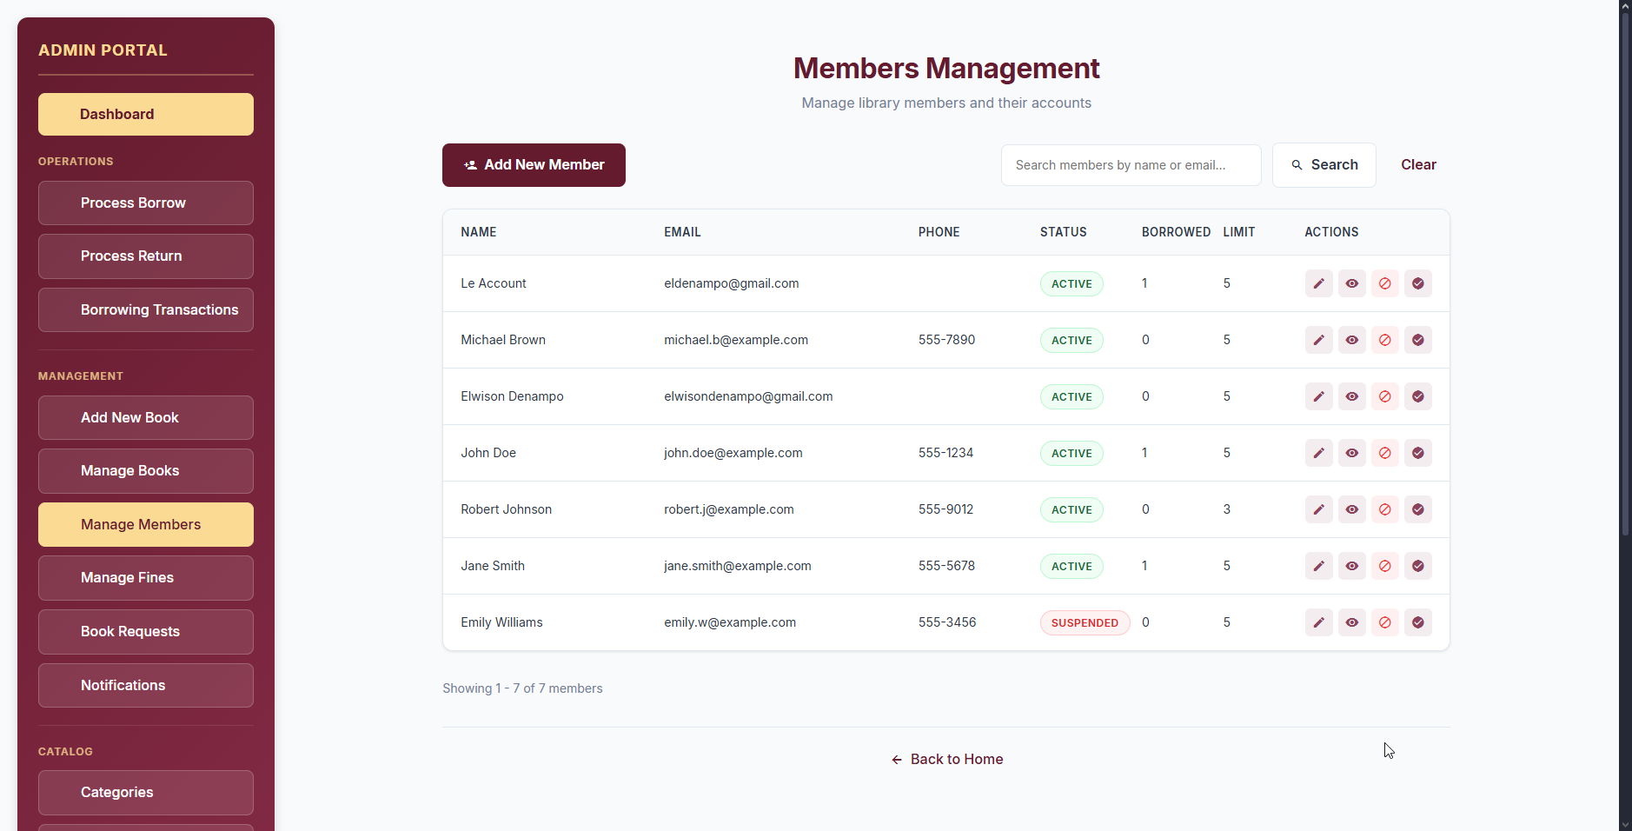
5.0 Members – List Page

Slide 63
5.0 Members – List Page Logic
Members/Index — Member List
Field: Search bar
Logic: Filter members by name or email
Action: Enter search term; Submit
Action Logic: Reload with searchTerm parameter
Field: Members table
Logic: Paginated display
Columns: Name, Email, Status (badge), Membership Date, Actions
Display: 20 members per page (default)
Action: Page load
Action Logic: Call IMemberService.GetMembersPaged(pageNumber, pageSize, searchTerm)
Returns PagedResult with members list and pagination metadata

Slide 64
5.0 Members – List Page Logic
Members/Index — Member List
Field: Pagination controls
Logic: Navigate between pages
Display: Previous, page numbers, Next
Action: Click page number
Action Logic: Navigate to /Members/Index?pageNumber={n}&searchTerm={term}
Field: Action buttons (per row)
View Details button
Action: Click
Action Logic: Navigate to /Members/Details?id={memberId}
Edit button
Action: Click
Action Logic: Navigate to /Members/Edit?id={memberId}
Suspend button (for Active members)
Action: Click
Action Logic: Navigate to /Members/Suspend?id={memberId}
Reactivate button (for Suspended members)
Action: Click
Action Logic: Navigate to /Members/Reactivate?id={memberId}

Slide 65
5.1 Members – CRUD Page Logic
Members/Create, Edit, Details, Suspend, Reactivate
Members/Create:
Similar logic to Admin/CreateAccount (Member section)
Admin only; Form for new member creation
Members/Edit:
Load existing member data
Update form; Validate; Call IMemberService.UpdateMember()
Members/Details:
Read-only display of all member information
Show borrowing history, fines, active transactions
Members/Suspend:
Confirmation page
OnPost: Update Status to Suspended; Redirect
Members/Reactivate:
Confirmation page
OnPost: Update Status to Active; Redirect

Slide 66
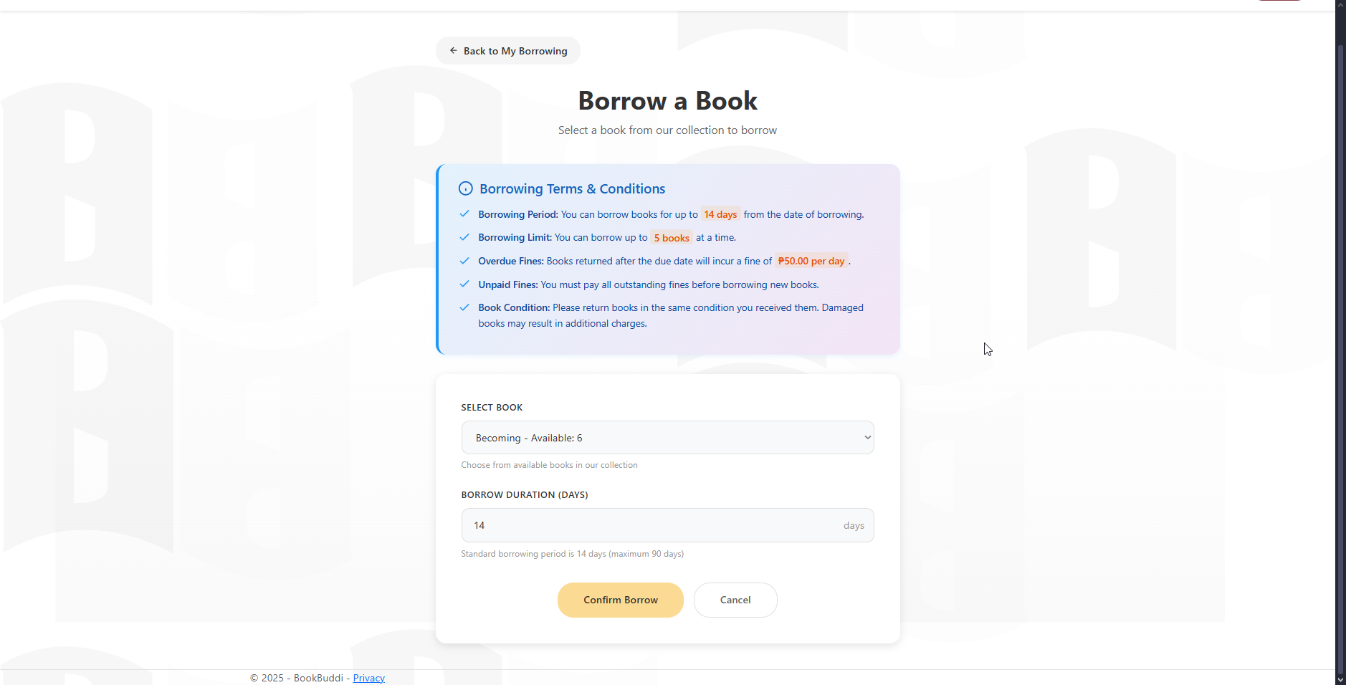
6.0 Borrowing – Borrow Page

Slide 67
6.0 Borrowing – Borrow Page Logic
Borrowing/Index — Transaction List
Field: Filter tabs
Logic: Filter by transaction status
Options: All, Active, Overdue, Returned
Action: Click filter tab
Action Logic: Reload with status parameter
Field: Transactions table
Logic: Role-based display
Admin: Show all transactions
Member: Show only their transactions
Columns: Member Name, Book Title, Borrow Date, Due Date, Status (badge), Actions
Action: Page load
Action Logic: Load transactions filtered by role and status
Field: Return Book button
Logic: Process book return
Action: Click "Return Book"
Action Logic: Navigate to /Borrowing/Return?id={transactionId}

Slide 68
6.0 Borrowing – Borrow Page Logic
Borrowing/Borrow — Borrow Book
Field: Member dropdown
Logic: Select borrower
Populated with: Active members only
If logged in as Member: Pre-select self; Disable dropdown
Field: Book dropdown
Logic: Select book to borrow
Populated with: Available books only (AvailableCopies > 0)
If bookId parameter provided: Pre-select book
Field: Terms and Conditions
Logic: Required acceptance checkbox
Validation: Must be checked to submit

Slide 69
6.0 Borrowing – Borrow Page Logic
Borrowing/Borrow — Borrow Book
Field: Borrow Book button
Logic: Create borrow transaction
Action: Click "Borrow Book"
Action Logic: Submit form; Validate selections
Get processedBy name from session (Admin or Member)
Call IBorrowingService.BorrowBook(memberId, bookId, processedBy)
Service validation:
Check member status is Active
Check member current borrow count < borrowing limit
Check book availability (AvailableCopies > 0)
Check member has no outstanding unpaid fines
If valid:
Create BorrowTransaction with DueDate = Today + 14 days, Status=Active
Decrement book AvailableCopies by 1
Increment member CurrentBorrowedCount by 1
Create notification for member
Send borrow confirmation email
Show success message; Reload form
If invalid:
Show error message with reason

Slide 70
6.0 Borrowing – Borrow Page Logic
Borrowing/Borrow — Borrow Book
OnGet Logic:
Load Active members dropdown
Load Available books dropdown
Pre-select book if bookId provided

Slide 71
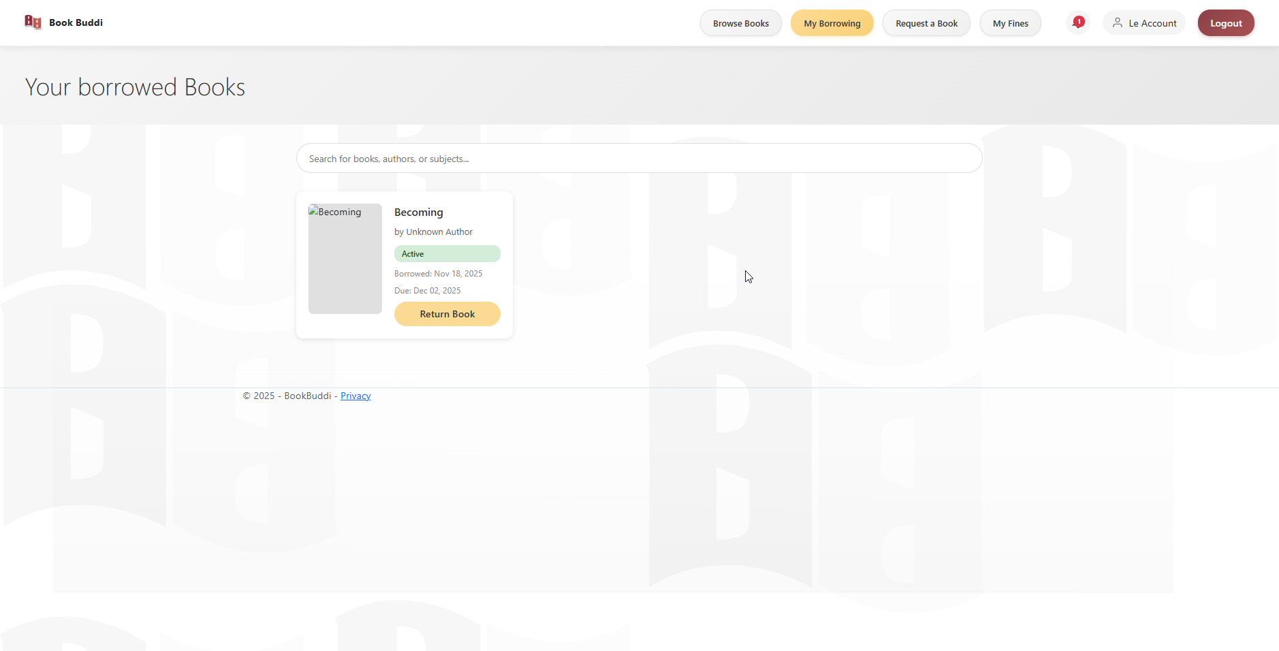
6.1 Borrowing – Return Book Page

Slide 72
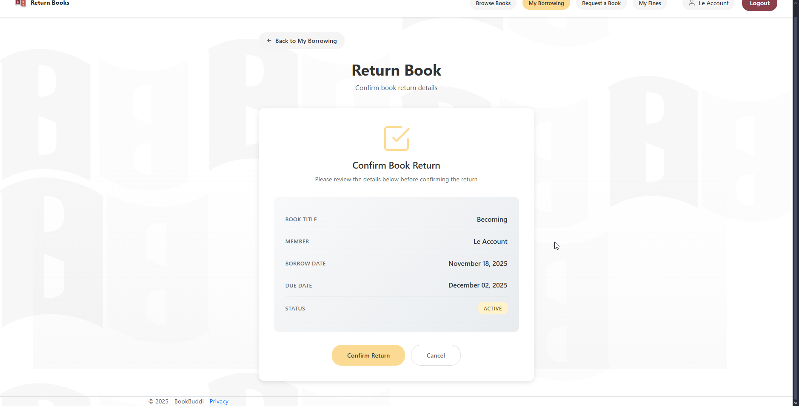
6.1 Borrowing – Return Book Page

Slide 73
6.1 Borrowing – Return Book Page Logic
Borrowing/Return — Return Book
Field: Transaction details display
Logic: Read-only confirmation
Display: Member name, Book title, Borrow date, Due date, Days borrowed (calculated)
Field: Confirm Return button
Logic: Process book return with fine calculation
Action: Click "Confirm Return"
Action Logic: Submit form
Get processedBy name from session
Call IBorrowingService.ReturnBook(transactionId, processedBy)
Service logic:
Update transaction: Status=Returned, ReturnDate=Today
Calculate overdue days: max(0, Today - DueDate)
If overdue:
Create Fine: Amount = overdues × ₱50.00, Reason=Overdue, Status=Unpaid
Create fine notification
Increment book AvailableCopies by 1
Update book Status to Available
Decrement member CurrentBorrowedCount by 1
Create return notification
Send return confirmation email
Redirect to /Borrowing/Index with success message

Slide 74
6.1 Borrowing – Return Book Page Logic
Borrowing/Return — Return Book
OnGet Logic:
Load transaction by ID
Load related member name
Load related book title
Calculate days borrowed

Slide 75
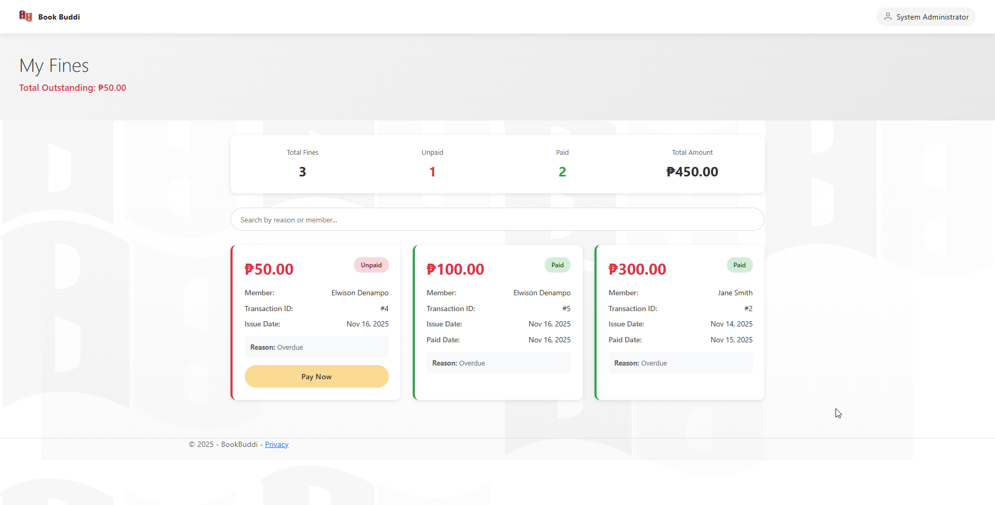
7.0 Fines – Fines List Page Logic

Slide 76
7.0 Fines – Fines List Page Logic
Fines/Index — Fines List
Field: Filter tabs
Logic: Filter by payment status
Options: All, Unpaid, Paid
Action: Click filter tab
Action Logic: Reload with status parameter
Field: Fines table
Logic: Role-based display
Admin: Show all fines
Member: Show only their fines
Columns: Member Name, Amount (₱), Reason (badge), Issue Date, Status (badge), Actions
Display: Total unpaid amount at top

Slide 77
7.0 Fines – Fines List Page Logic
Fines/Index — Fines List
Field: Total Unpaid display
Logic: Sum unpaid fines
Action: Page load
Action Logic: Calculate sum of Amount where Status=Unpaid
Field: Pay Fine button
Logic: Process payment
Action: Click "Pay Fine"
Action Logic: Navigate to /Fines/Pay?id={fineId}

Slide 78
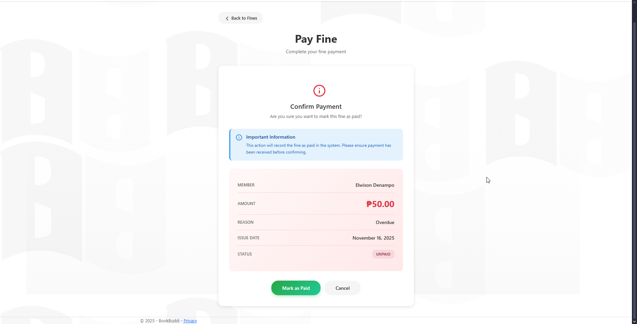
7.1 Fines – Pay Fine Page

Slide 79
7.1 Fines – Pay Fine Page Logic
Fines/Pay — Pay Fine
Field: Fine details display
Logic: Read-only confirmation
Display: Member name, Amount (in Philippine Pesos ₱), Reason, Issue date
Field: Confirm Payment button
Logic: Mark fine as paid
Action: Click "Confirm Payment"
Action Logic: Submit form
Get updatedBy name from session
Call IFineService.PayFine(fineId, updatedBy)
Service logic:
Update fine: Status=Paid, PaymentDate=Today
Create notification for member (fine paid)
Redirect to /Fines/Index with success message
OnGet Logic:
Load fine by ID
Load related member name
Display fine details

Slide 80
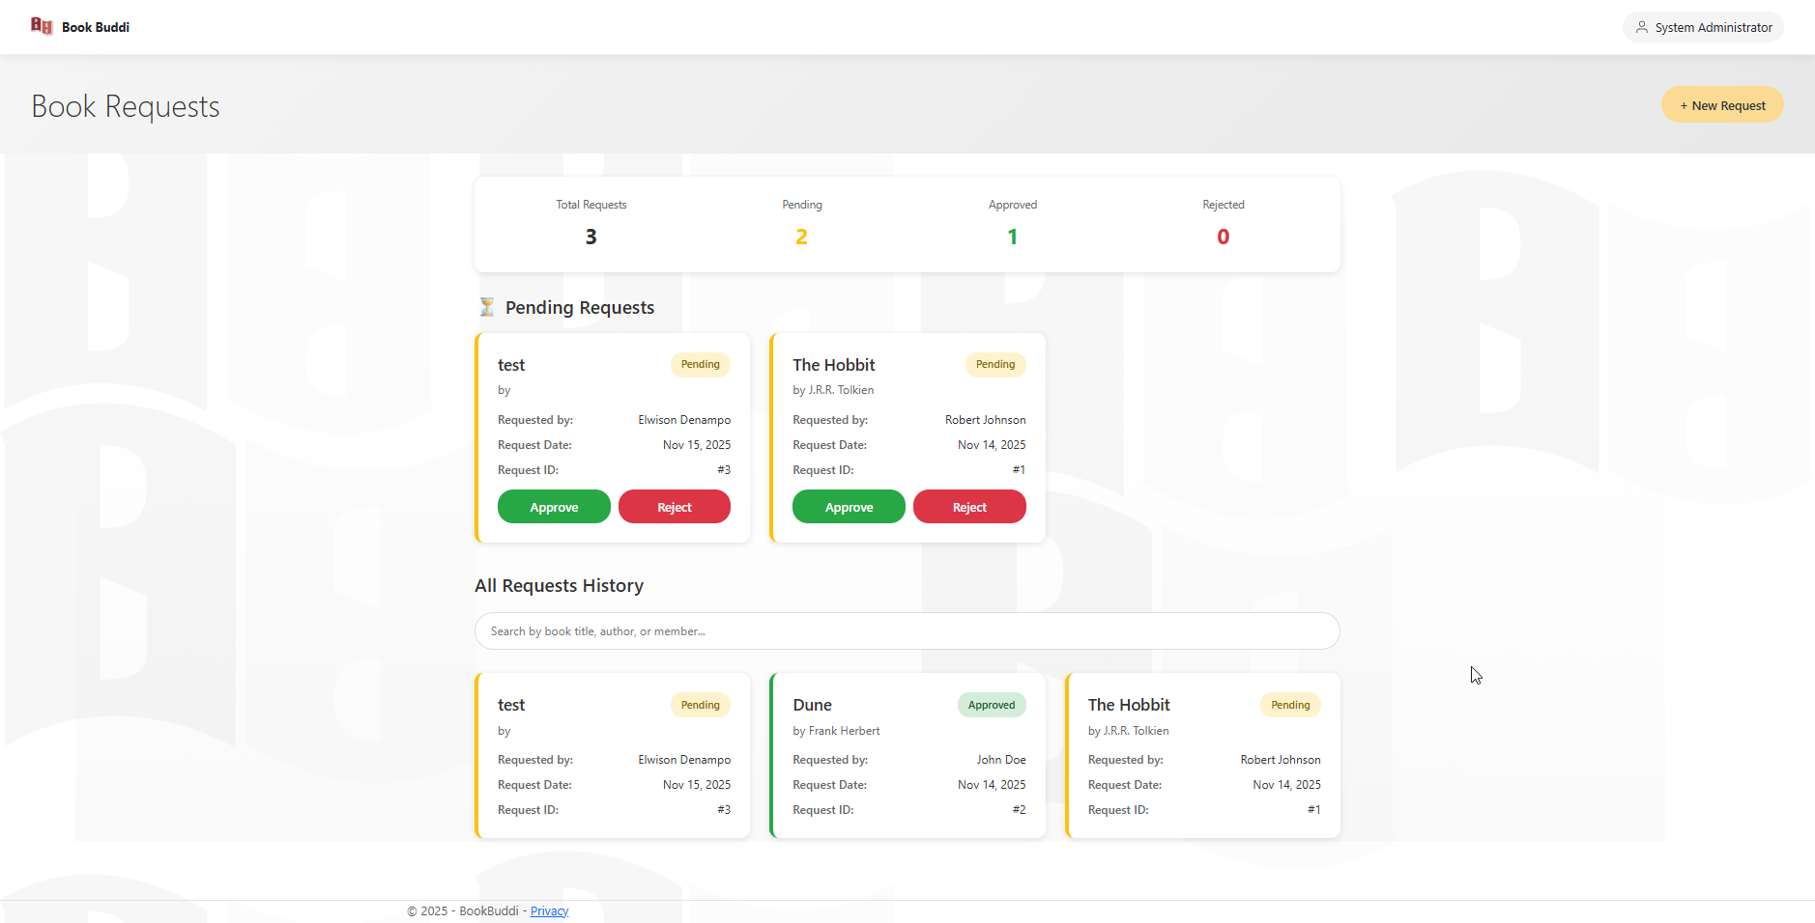
8.0 Book Requests – Requests List Page

Slide 81
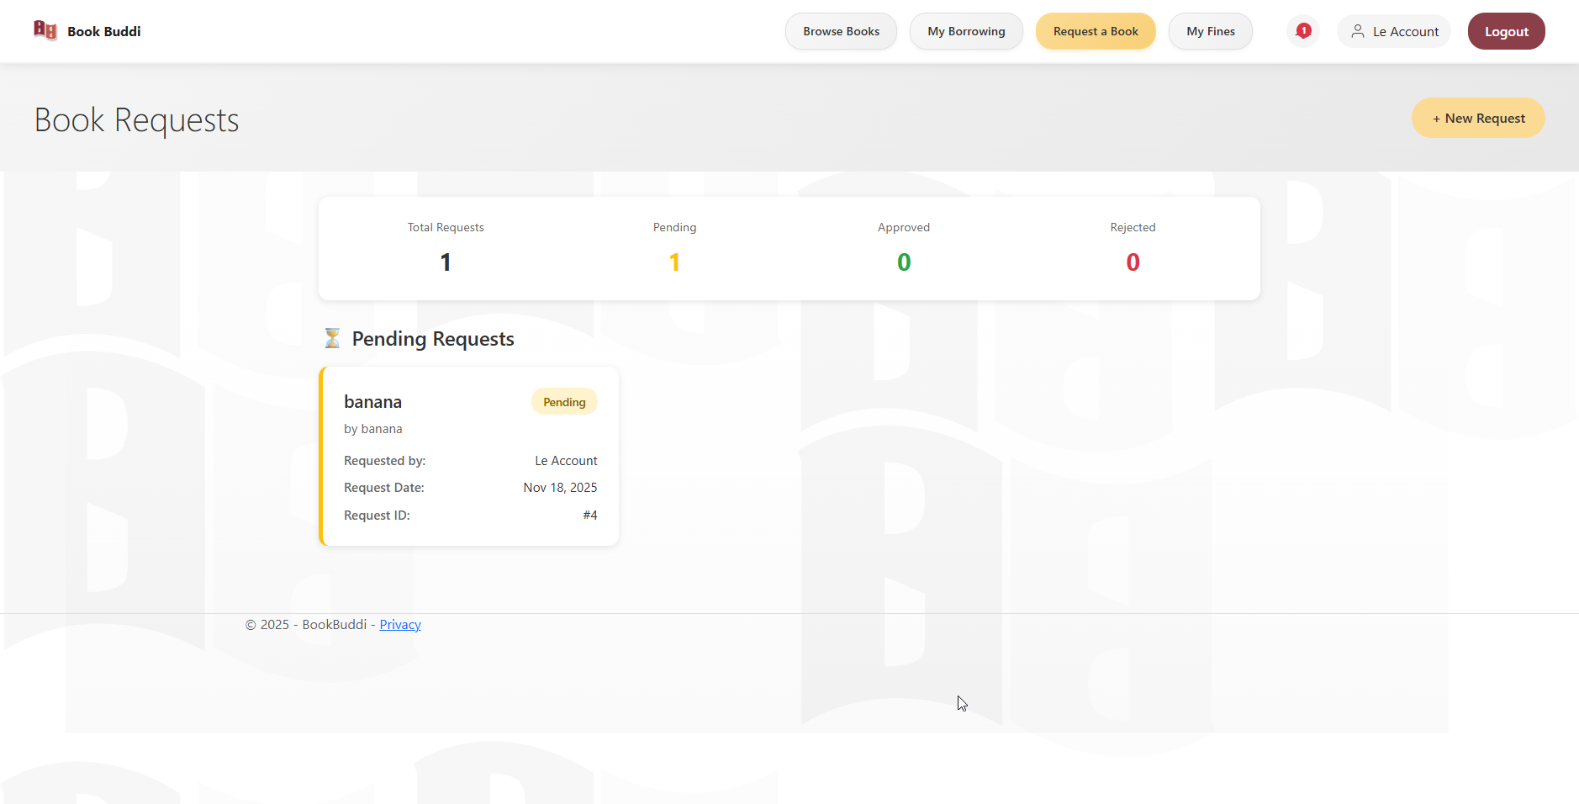
8.0 Book Requests – Requests List Page

Slide 82
8.0 Book Requests – Requests List Page Logic
BookRequests/Index — Requests List
Field: Requests table
Logic: Role-based display
Admin: Show all requests
Member: Show only their requests
Columns: Member Name, Book Title, Author, Request Date, Status (color-coded badge), Actions
Status colors: Pending (orange), Approved (green), Rejected (red), Fulfilled (blue), Cancelled (gray)
Field: Action buttons (Admin, for Pending requests)
Approve button
Action: Click "Approve"
Action Logic: Navigate to /BookRequests/Approve?id={requestId}
Reject button
Action: Click "Reject"
Action Logic: Navigate to /BookRequests/Reject?id={requestId}

Slide 83
8.0 Book Requests – Requests List Page Logic
BookRequests/Index — Requests List
Field: Create New Request button (Member)
Logic: Navigate to request form
Action: Click "Create New Request"
Action Logic: Navigate to /BookRequests/Create
OnGet Logic:
Load requests based on role
Enrich with member names
Load notifications (for members)

Slide 84
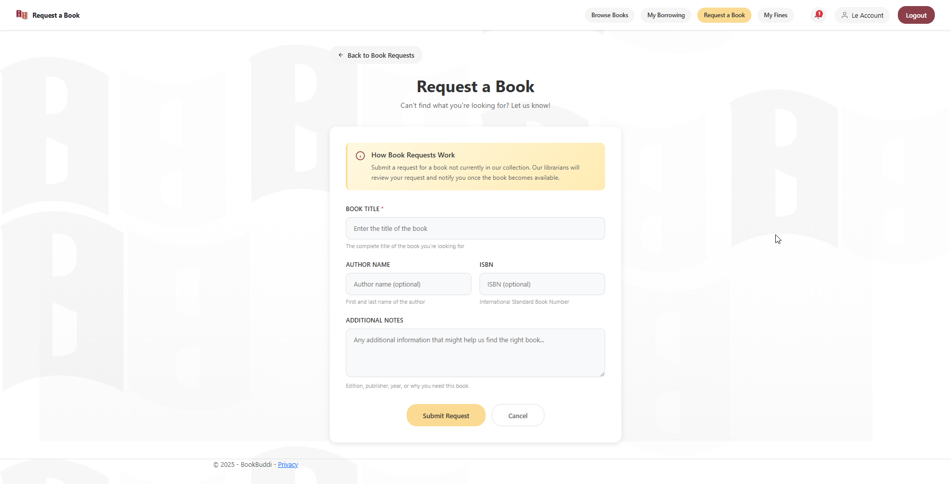
8.1 Book Requests - Create Page

Slide 85
8.1 Book Requests - Create Page Logic
BookRequests/Create — Submit Request
Field: Book Title input
Logic: Required field
Validation: Not empty, max 300 chars
Field: Author Name input
Logic: Required field
Validation: Not empty, max 200 chars
Field: ISBN input
Logic: Optional field
Validation: Max 13 chars if provided
Field: Additional Notes textarea
Logic: Optional field
Validation: Max 1000 chars

Slide 86
8.1 Book Requests - Create Page Logic
BookRequests/Create — Submit Request
Field: Submit Request button
Logic: Create new request
Action: Click "Submit Request"
Action Logic: Submit form; Validate fields
Get memberId from session
Create BookRequestViewModel with:
BookTitle, AuthorName, ISBN (optional), MemberNotes
RequestDate=Today, Status=Pending
Call IBookRequestService.CreateRequest()
Create notification for admins
Redirect to /BookRequests/Index with success message

Slide 87
8.2 Book Requests – Approve Request Page Logic
BookRequests/Approve — Approve Request
Field: Request details display
Logic: Read-only confirmation
Display: Member name, Book title, Author, ISBN, Request date, Member notes
Field: Admin Notes textarea
Logic: Optional admin comments
Validation: Max 1000 chars

Slide 88
8.2 Book Requests – Approve Request Page Logic
BookRequests/Approve — Approve Request
Field: Confirm Approval button
Logic: Update request status
Action: Click "Confirm Approval"
Action Logic: Submit form
Get admin name from session
Call IBookRequestService.ApproveRequest(requestId, adminNotes, adminName)
Service logic:
Update request: Status=Approved, AdminNotes, StatusUpdateDate=Today
Create notification for requesting member
Send email notification
Redirect to /BookRequests/Index with success

Slide 89
8.3 Book Requests – Reject Request Page Logic
BookRequests/Reject — Reject Request
Similar to Approve:
Display request details
Admin notes textarea
Confirm Rejection button
Update Status=Rejected
Notify member

Slide 90
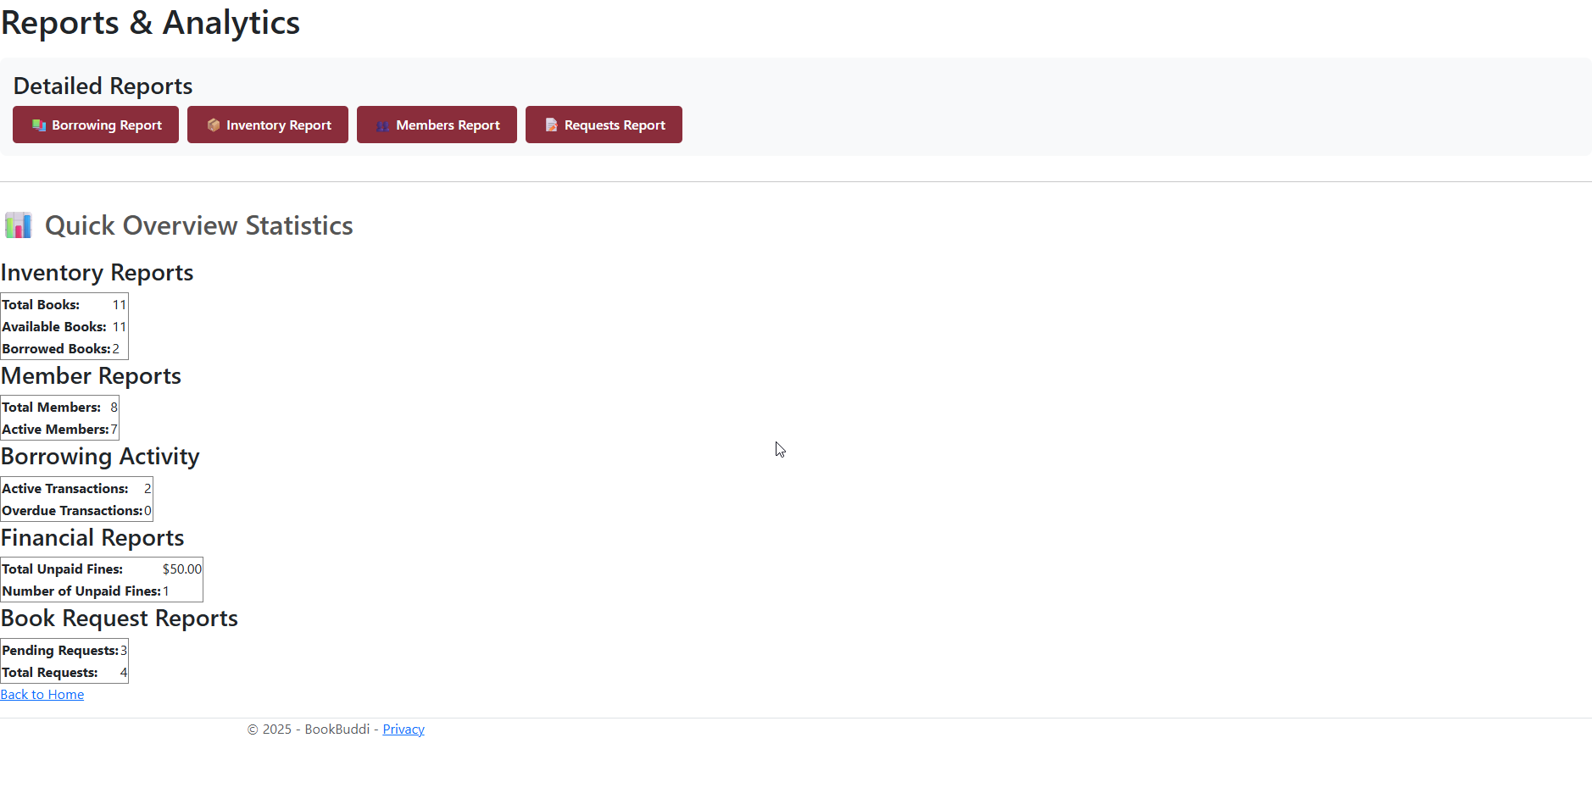
9.0 Reports – Reports Menu Page

Slide 91
9.0 Reports – Reports Menu Page Logic
Reports/Index — Reports Menu
Field: Report category cards
Logic: Navigation to specific reports
Cards: Borrowing Report, Inventory Report, Members Report, Requests Report
Each card: Icon, title, description, "View Report" button
Action: Click "View Report"
"Borrowing Report" → Navigate to /Reports/Borrowing
"Inventory Report" → Navigate to /Reports/Inventory
"Members Report" → Navigate to /Reports/Members
"Requests Report" → Navigate to /Reports/Requests

Slide 92
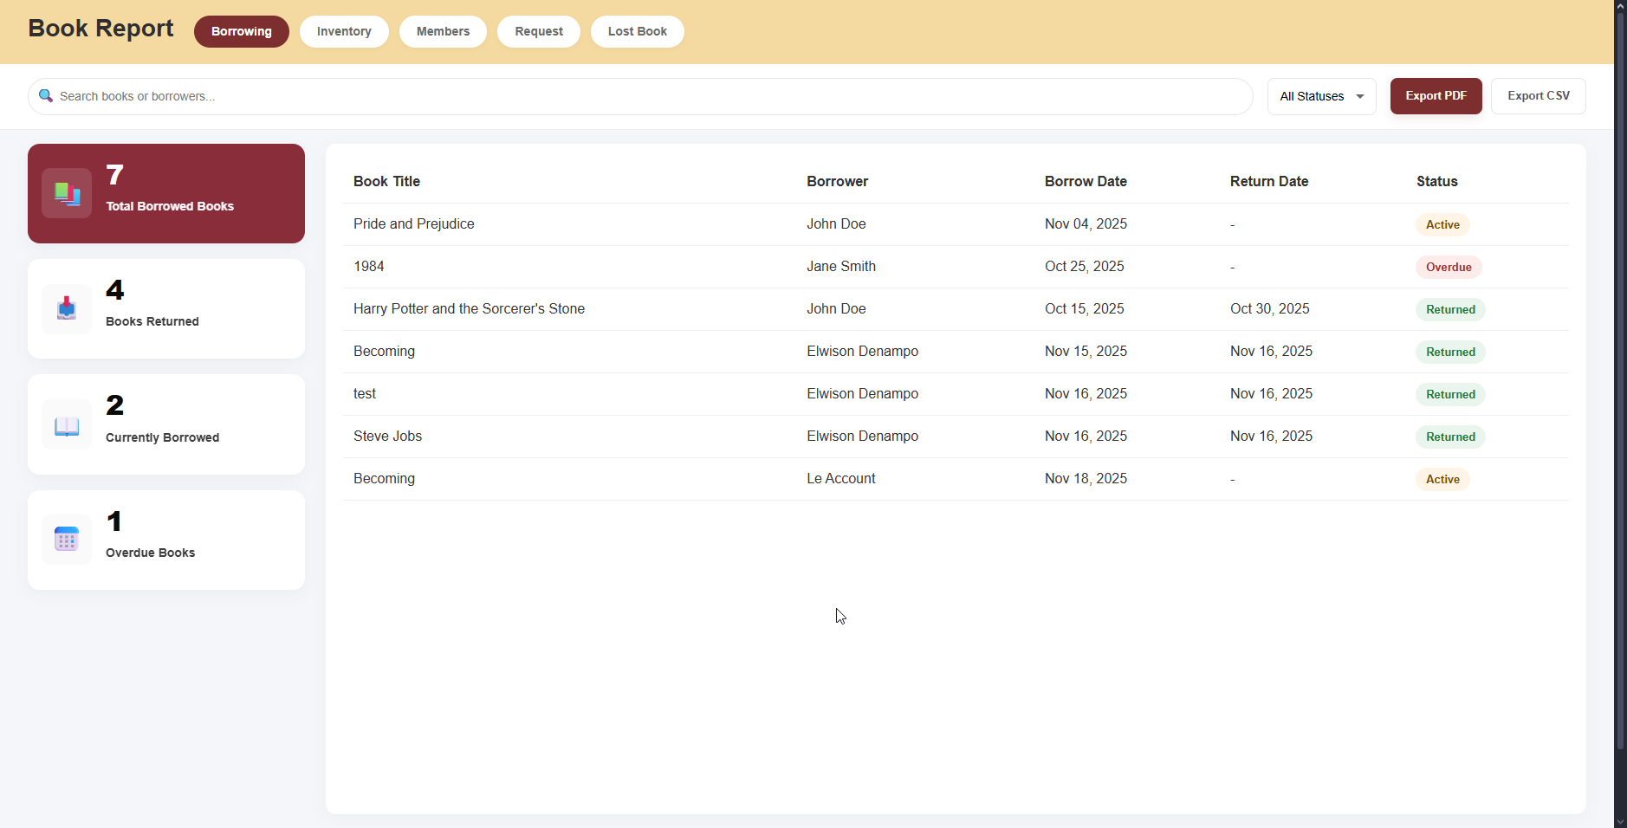
9.1 Reports – Borrowing, Inventory, Member, Requests Pages

Slide 93
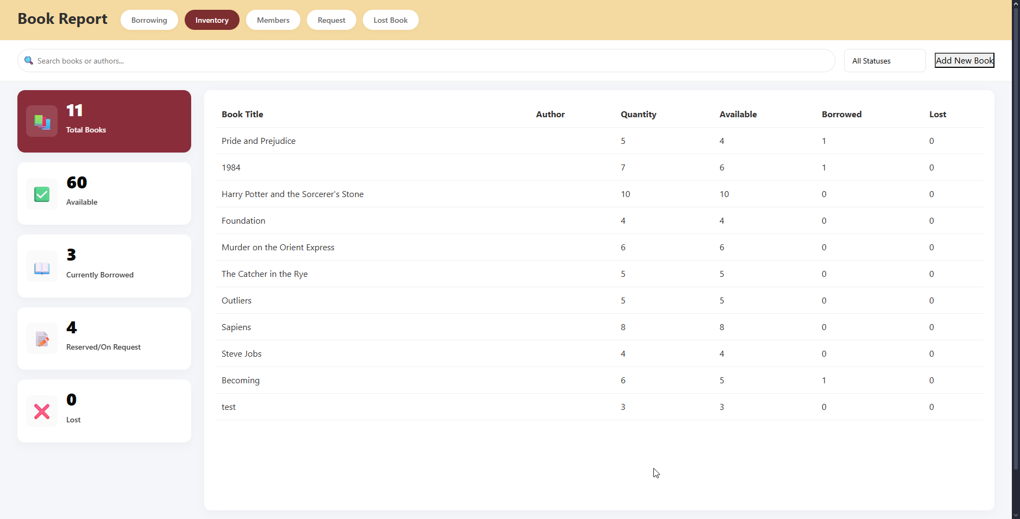
9.1 Reports – Borrowing, Inventory, Member, Requests Pages

Slide 94
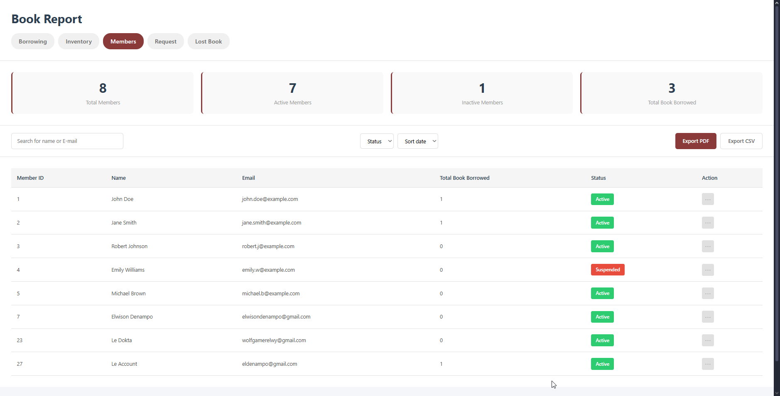
9.1 Reports – Borrowing, Inventory, Member, Requests Pages

Slide 95
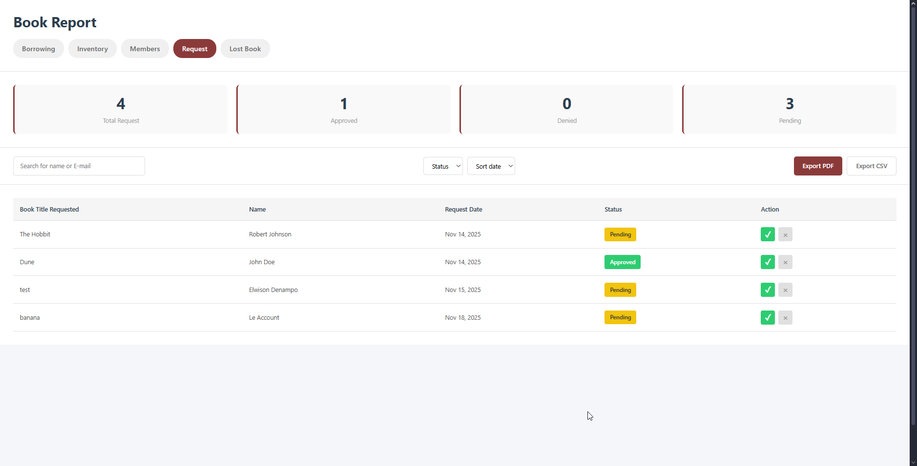
9.1 Reports – Borrowing, Inventory, Member, Requests Pages

Slide 96
9.1 Reports – Borrowing, Inventory, Member, Requests Pages Logic
Reports/Borrowing, Inventory, Members, Requests
Common Pattern:
Field: Date range filter
Logic: Filter data by date range
Inputs: Start Date, End Date
Action: Submit filter
Action Logic: Reload with date parameters
Field: Statistics display
Logic: Aggregate data visualization
Display: Cards, charts, tables
Action: Page load
Action Logic: Query database with filters; Calculate metrics; Render charts
Field: Export buttons
Logic: Download report in various formats
Options: Export to CSV, Export to PDF
Action: Click export button
Action Logic: Generate file; Trigger download

Slide 97
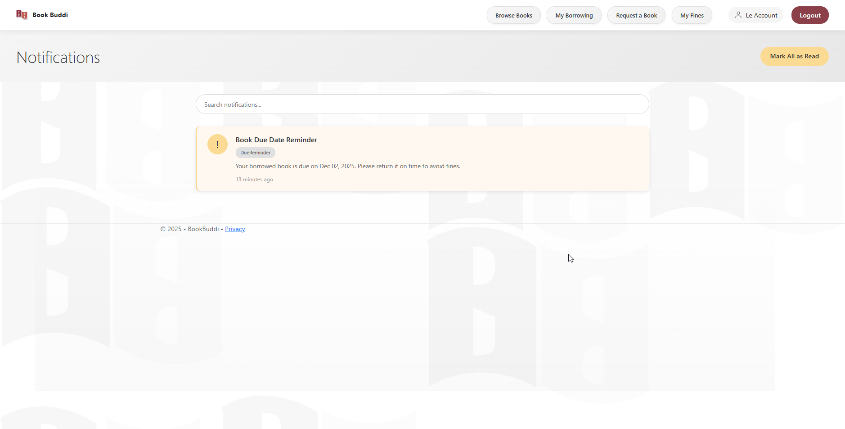
10.0 Notification Pages

Slide 98
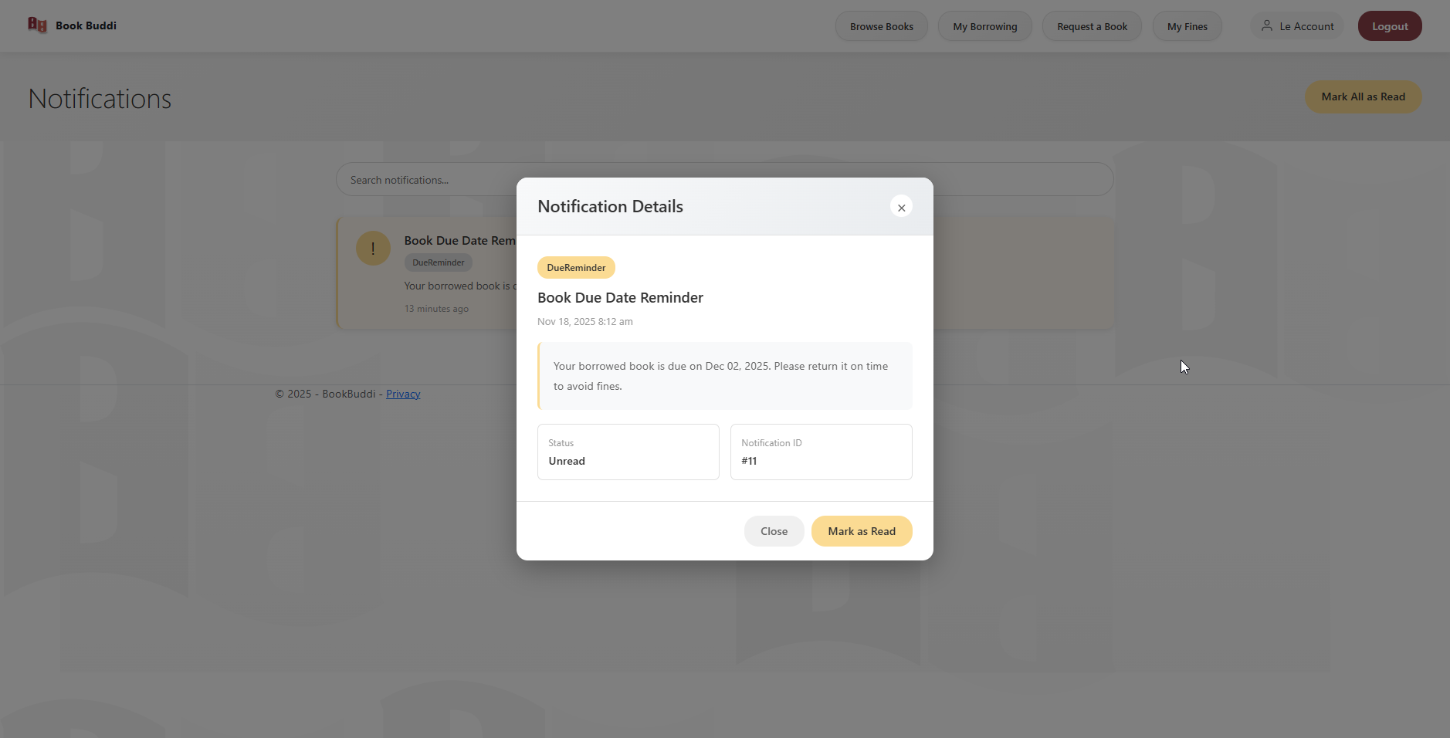
10.0 Notification Pages

Slide 99
10.0 Notification Pages Logic
Notifications/Index — All Notifications
Field: Filter tabs
Logic: Filter by read status
Options: All, Unread, Read
Action: Click filter tab
Action Logic: Filter notifications list; Update display
Field: Mark All as Read button
Logic: Bulk update read status
Action: Click "Mark All as Read"
Action Logic: Update all notifications: IsRead=true, DateRead=Now; Reload page

Slide 100
10.0 Notification Pages Logic
Notifications/Index — All Notifications
Field: Notification cards
Logic: Display notification details
Each card: Indicator dot (unread=colored, read=gray), Title, Message, Timestamp
Action: Click notification card
Action Logic: If unread: Mark as read; Display full details in modal or navigate to details page
Field: Pagination
Logic: Navigate through notifications
Display: 20 per page
Action: Click page number
Action Logic: Load page with notifications
OnGet Logic:
Get memberId from session
Load all notifications for member
Apply filter (All/Unread/Read)
Order by DateCreated descending

Slide 101


